Slide 1
Valley Forge and European Aid

Slide 2
Stalemate and Financial Troubles
Following the victory at Saratoga, the war in the North stalemated
British were unable to finish off Washington’s army
Washington was unable to stand up to the British
Continued to suffer from lack of supplies: food, clothing, and other essentials; help from the French was slow coming

Slide 3
Stalemate and Financial Troubles
Why couldn’t the Continental Congress buy supplies for their army? Where do governments get their money from?
TAXES!
Using what we know about the reasons for the war, why do you think the Continental Congress was unable to tax the colonials?

Slide 4
Stalemate and Financial Troubles
Congress lacked the power to tax
Could only ask the states for funds
States wanted to make sure their own militias and states were provided for.
Can you see any problems with a federal government that can’t tax?
A government that can’t tax will be very weak and unable to provide for itself

Slide 5
Valley Forge
The American army led by Washington continued to be undersupplied and underfed
Marched into winter quarters at Valley Forge at the end of 1777
“You might have tracked the army…by the blood of their feet.”
- G. Washington

Slide 6
Valley Forge
Spent entire winter in bitter cold
No food
Inadequate clothing
Frostbite
Disease
The majority of deaths during the war will be from diseases
17,000 from diseases, only 8,000 from battle
2,000 died at Valley Forge alone

Slide 7
Amazing resolve and fortitude to continue on through those conditions
Just need to channel that drive and determination in the proper direction

Slide 8
Baron Von Steuben
During the stay at Valley Forge, the Continentals were joined by Baron Friedrich Von Steuben
Professional soldier from Prussia who volunteered to join the American cause

Slide 9
Baron Von Steuben
Trained the army
Taught Americans (using of a model company and translators)how to march and move together, load quickly, use a bayonet
Organized camp life
Improved sanitation conditions
Lowered spread of diseases

Slide 10
European Professional Volunteers
Von Steuben is just one example of European volunteers that believed strongly in the Enlightenment ideals of the Revolution
What was Von Steuben’s profession before the war?
SOLDIER!

Slide 11
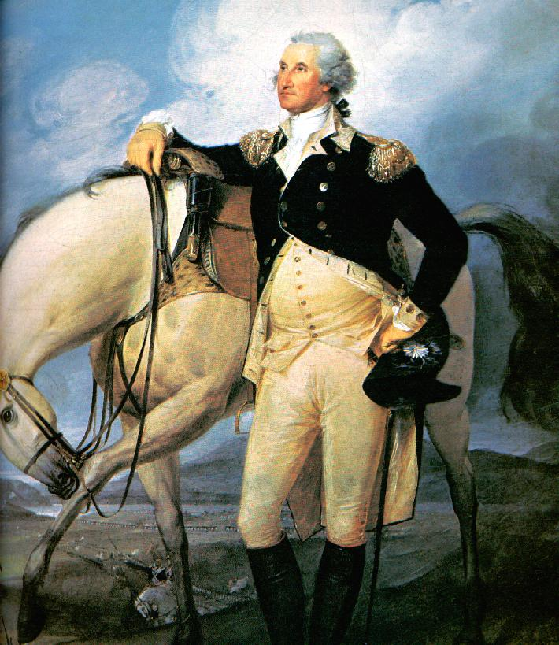
George Washington
American
Farmer/Surveyor

Slide 12
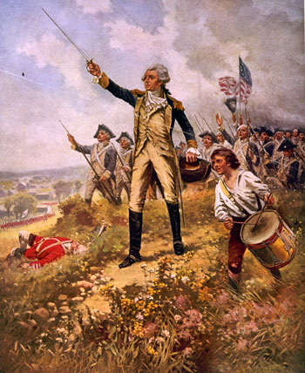
Marquis de Lafayette France Soldier
Marquis de Lafayette
French
Soldier

Slide 13
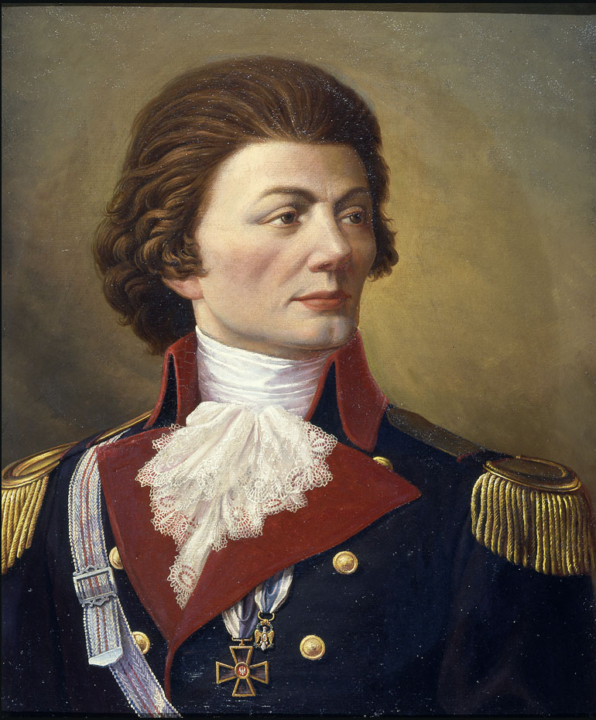
Thaddeus Kosciusko
Polish
Soldier

Slide 14
George Rogers Clark
American
Farmer

Slide 15
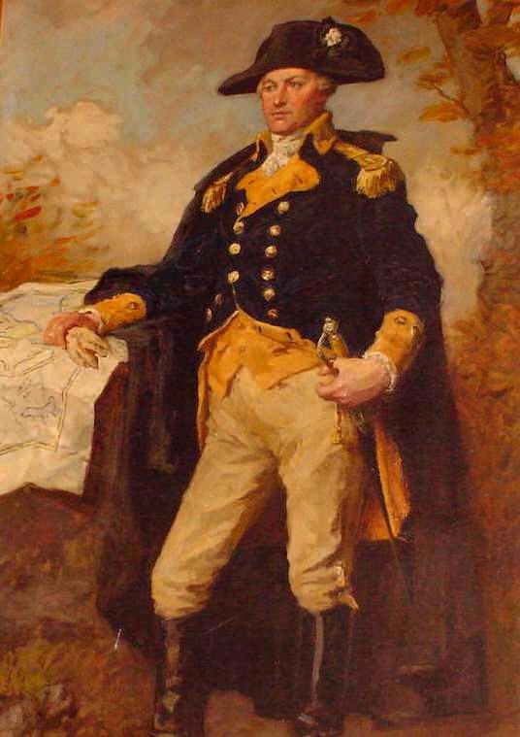
Nathanael Greene
American
Iron Worker/Anchor Maker

Slide 16
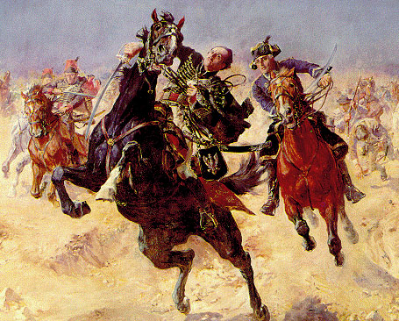
Casimir Pulaski
Polish
Soldier

Slide 17
Daniel Morgan
American
Wagoneer

Slide 18
Bernardo de Galvez
Spanish
Soldier

Slide 19
Alexander Hamilton
Nevis (American)
Accountant

Slide 20
Benedict Arnold
American
Apothecary (Pharmacist)

Slide 21
John Paul Jones
Scottish
Sailor

Slide 22
Francis Marion
American
Farmer/Politician

Slide 23
Henry Knox
American
Book Salesman

Slide 24
What patterns can we see in the Continental officers?
Americans were not professionals!
The European volunteers were!
These professionals were essential in transforming
the Continentals from a group of farmers, to a true army!

