Slide 1
The Louisiana Purchase

Slide 2
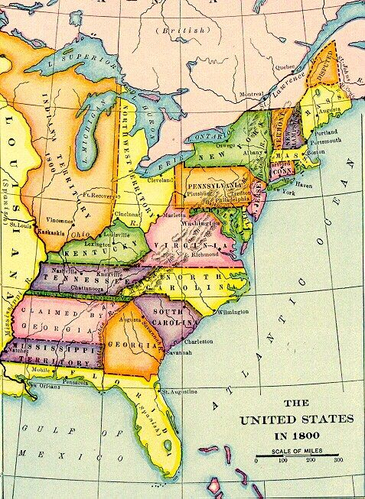
A Changing Nation
By 1800, the shape of the nation was changing
Moving westward
About 1,000,000 Americans living west of Appalachian Mountains
Kentucky
Tennessee
Ohio
Most of these early settlers were farmers

Slide 3
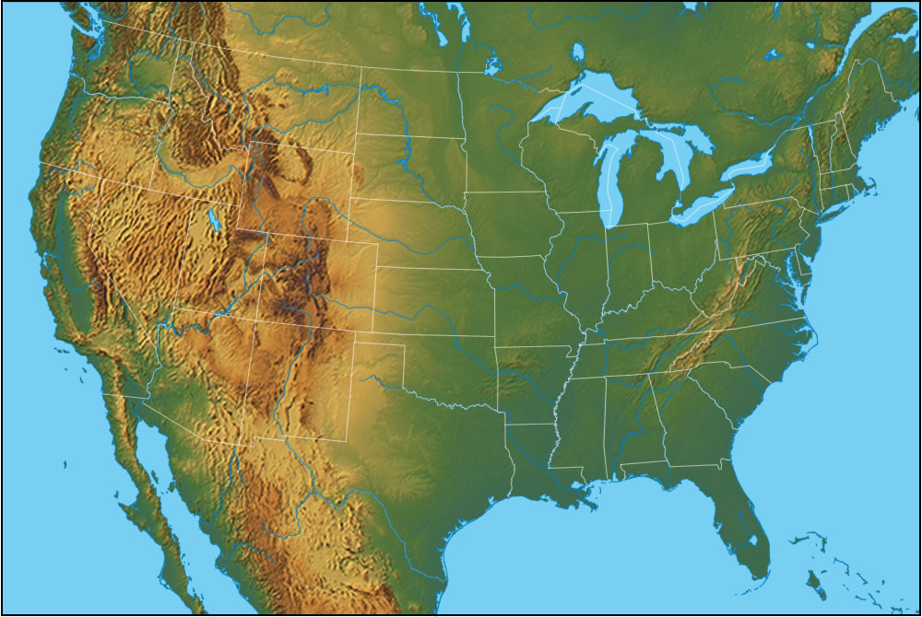
Are there any major obstacles in going from Point A to Point B?
B
A.

Slide 4
B
A.

Slide 5
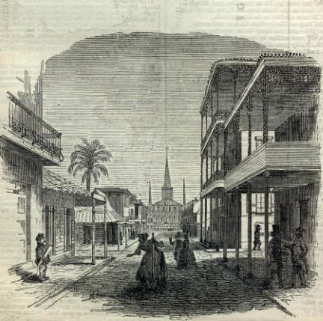
Problems in New Orleans
The City of New Orleans was controlled by the French.
French commonly threatened to cut off New Orleans (and entire use of Mississippi) to the American settlers
This control of Mississippi River also blocked American expansion to the west.

Slide 6
What are some possible solutions to this problem?
Jefferson decides to buy New Orleans for $10 Million. Sends delegates to make a deal with Napoleon.

Slide 7
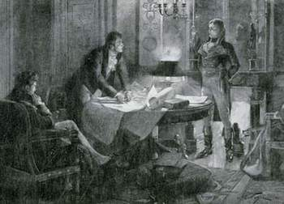
Napoleon Makes an Offer
Napoleon needs cash
Money needed to fight Great Britain
Offers to sell ALL of Louisiana for only $15 Million

Slide 8
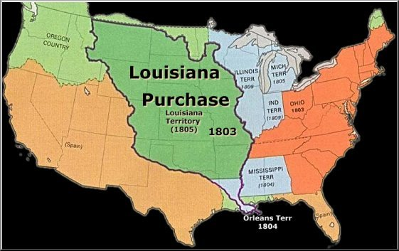
Louisiana Purchase
The Louisiana Purchase:
Gave US total control of the Miss. River
Almost doubled size of US
Cost less than 4 cents per acre
Helped trend of westward expansion

Slide 9
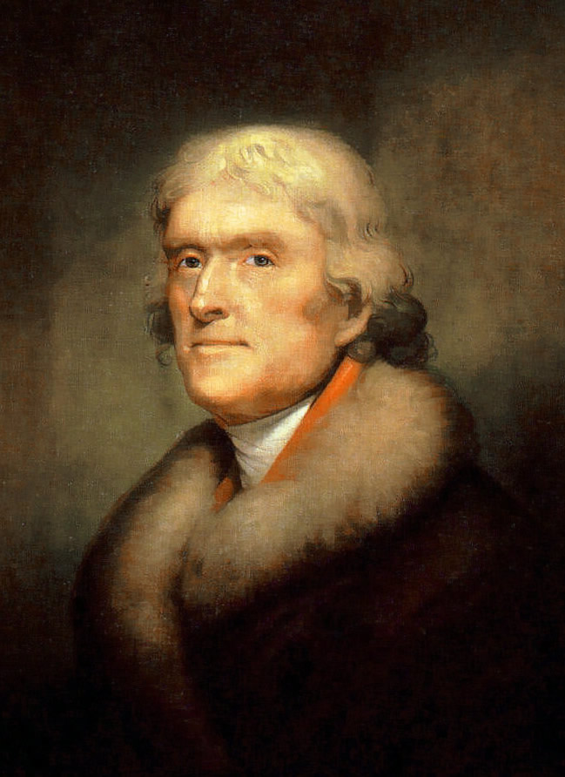
Was it Legal?
Jefferson bought this territory, but it doesn’t say anywhere in the Constitution that the President can buy land.
How does Jefferson want the Constitution to be interpreted?
Jefferson decided since he could make a treaty that was then approved by Congress it was within his power.

Slide 10
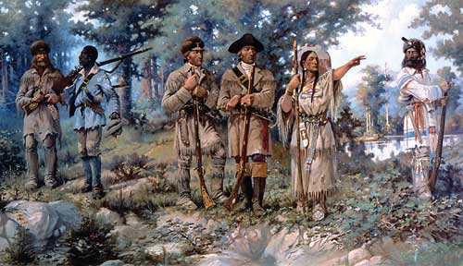
Lewis and Clark Expedition
To find out exactly the U.S. had bought, Jefferson sends his clerk Meriwether Lewis and William Clark to explore and establish American presence in this new territory.

