Slide 1
The Civil War

Slide 2
The South Confederate States of America
President- Jefferson Davis
Geographically large, but small total population
9 million
1/3 of population were slaves
11 states
More joined after Lincoln called for volunteers to put down the rebellion
Plantation based economy
Reliant on export of cotton
European nations want to enter in as allies of the CSA
Few factories
Poor transportation
Based on what we know about the Articles of Confederation, what sort of federal government will the CONFEDERATE States of America have?

Slide 3
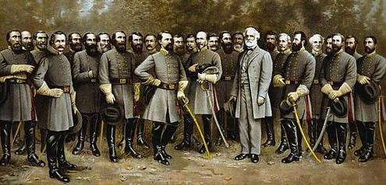
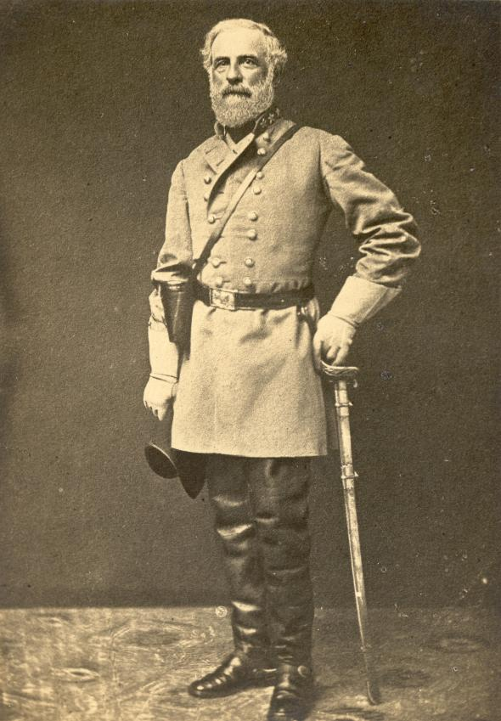
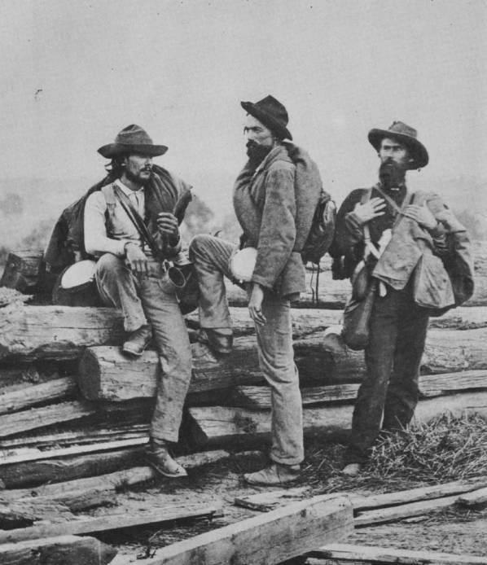
The South Confederate States of America
The CSA is going to have a weak federal government
Unable to draft soldiers or tax states to provide for an army
This along with the economic limitations in the south is going to have the “Rebel” army be underequipped and ill supplied when compared to the North
No navy
The biggest advantage the South will have is its talented officers and leaders of the army
Robert E. Lee
Albert S. Johnston
Thomas “Stonewall” Jackson
James Longstreet
Joseph Johnston
All heroes from Mexican War

Slide 4
The North: The United States of America
25 States
Free AND slave states
Lincoln, not wanting to alienate slave “border states” did not end slavery right away, his main goal was to preserve the Union
Economically strong
Factories - Farmland
Railroads - Population
Resulted in the North being able to create and maintain a much larger and well supplied army and navy
32,000 firearms produced for every 100 in the South
4,000 miles of railroad laid in north vs. 400 in the South

Slide 5
The North: The United States of America
President- Abraham Lincoln
Head of a strong federal government that was able to pass several laws to aid the war effort
Homestead Act
Land-Grant College Act
Pacific Railway Act
Legal Tender Act
1st income tax
Suspend habeas corpus
Held personal characteristics that aided the Union
Powerful public speaker
Sense of humor

Slide 6
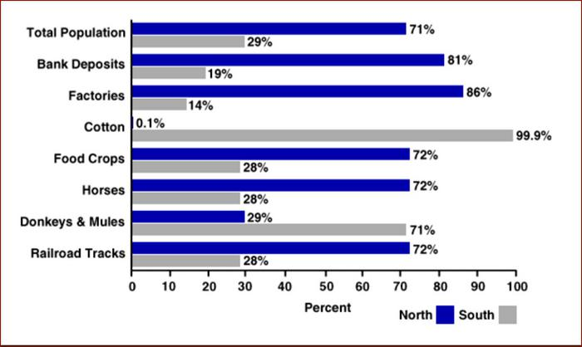

Slide 7
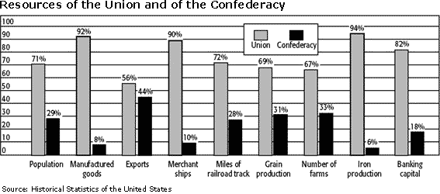

Slide 9
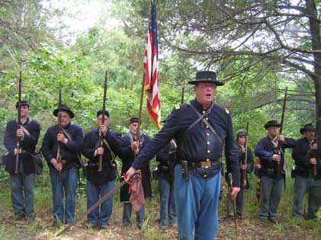
High Hopes
Something that both the North and South had in common was their intense military fervor
Both confident of victory
Huge participation numbers
South: ¾ of white male population fought
North: 2/3 of males fought
Teens lied about age in order to enlist
Most thought the war would be over before they had time to get into the army
Broke up families and friendships
“Brother Against Brother”

Slide 10
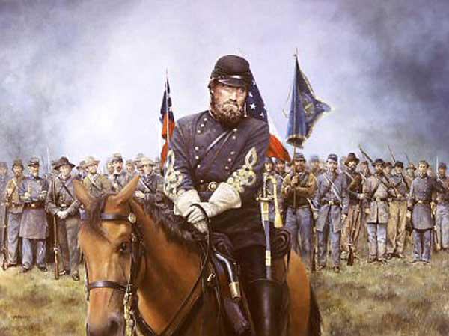
1st Bull Run
1st major battle of the war was at Bull Run served as a ‘wake up call’ for both sides
Both sides confident of victory
Crowds from Washington accompanied the army, bringing picnic baskets
Retreated in panic back to the capital with the army Rebel army in too bad of shape to pursue
Proved that the war is going to be long and bloody

Slide 11
Eastern and Western Theaters
The war was fought primarily in two main areas, or theaters
Eastern: gained more attention- larger armies, closer to both capitals, dominated newspapers
Western: Northern plan was to control the Mississippi River and squeeze life out of South

Slide 12
Eastern Theater
Early in the war, the South dominates
Smaller army, less equipped soldiers are able to level the playing field because of their superior generals
Robert E. Lee: dominates Union army again and again
Seven Days
2nd Bull Run:
Lincoln replaces general in command and can not seem to find the right one to win a victory
Lee decides to take the war to the North and maybe end it

Slide 13
Western Theater
War in the West is going much better for the U.S.
Ulysses S. Grant
Earns the nickname “Unconditional Surrender” Grant for his method of fighting
Wins victories over CSA and continues his goal of controlling major cities and forts along the Mississippi
Fort Henry
Fort Donelson
Shiloh
More causalities than all previous U.S. war combined
CSA Gen. Johnston dies

Slide 14
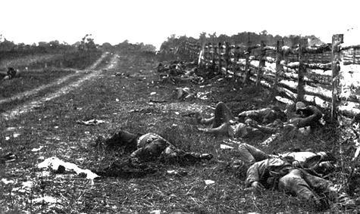
Antietam
Trying to press his advantage, Lee decides to invade the north.
Thinks that a victory on US territory will help bring a quick end to the war
Meets McClellan’s army at Antietam Creek in Maryland
Bloodiest 1 Day in entire war
Tie, but Lee retreats back to CSA

Slide 15
Emancipation Proclamation
The biggest result of Antietam was allowing Lincoln to pass the Emancipation Proclamation, which freed all slaves in the Confederacy
Lincoln had wanted to end slavery and was under pressure from abolitionists and members of Republican party to do so
Needed a victory to validate
Thought it would hurt economy of CSA
Keep European nations from entering the war
DID THE EMANCIPATION PROCLAMATION END SLAVERY EVERYWHERE? WHY OR WHY NOT?

Slide 16
Emancipation Proclamation
The Proclamation did NOT end slavery in the slave states that stayed in the Union or were now under Union control, only in the CSA.
Why do you think Lincoln wrote
the Proclamation this way?

Slide 17
Effects of the Emancipation Proclamation
The war would now have 2 goals
Restore the Union
Free slaves
Ended chance of European intervention
African support for the war increases
80% of all eligible African Americans joined the army
10% of all soldiers at the end of the war were black
54th Massachusetts
Varied responses from soldiers and citizens
Convinces Lincoln to on necessity for full citizenship for African Americans

Slide 18
South Gains Momentum
Following Antietam, the CSA wins largest battles of the war and Lincoln continues to look for a general that can match Lee and Jackson
Battle of Fredericksburg, Lee crushes Burnside
Lee wins largest victory for the south by defeating General Hooker at Chancellorsville
Jackson dies after the battle
HOW DOES JACKSON’S AND JOHNSON’S DEATHS PRESENT A HUGE PROBLEM FOR THE SOUTH?

Slide 19
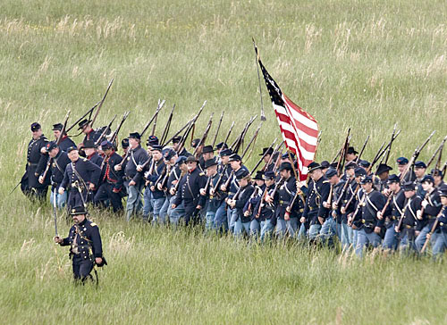
Changing Technology
One of the big reasons the Civil War is the most devastating conflict in American history is because of the huge amount of new technology that was developed.
Minie Ball: more accurate and shoots further than musket balls
Commanders still fought in straight lines despite the fact it the minie ball makes this style obsolete
1 out of 4 soldiers never returned

Slide 20
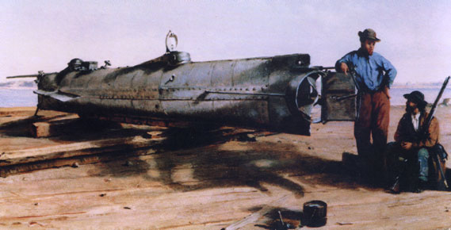
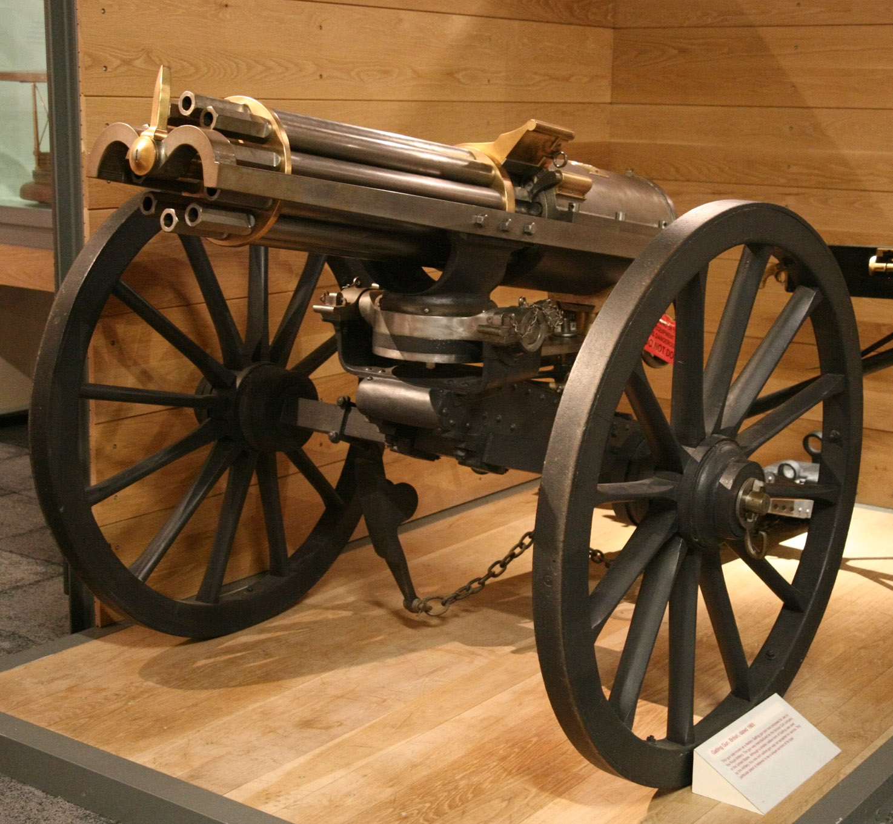
Changing Technology
The Civil War is considered by many to be the first “modern” or “industrial war”
It saw the use of the first:
Landmines
Air recon
Telegraph
Railroad
Submarine
Machine Gun
Self-Contained Bullet

Slide 21
Changing Technology
The Civil War was also the last time, wooden ships played a major role in warfare
Steam powered ironclad ships were the future and used by both sides. USS Monitor vs. CSS Virginia squared off against one another at the Battle of Hampton Roads in the first clash of ironclads.

Slide 22
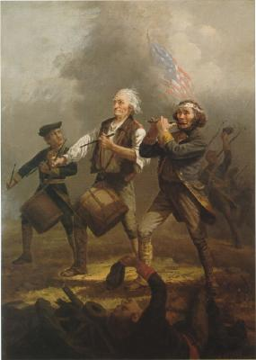
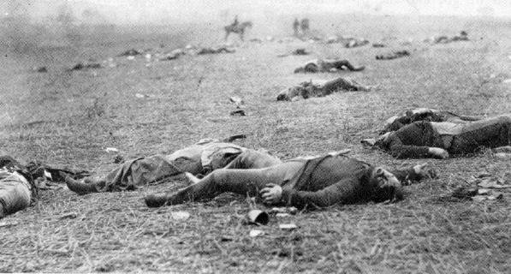
Changing Technology
For the first time, the carnage of war was captured on cameras which were recently invented.
Matthew Brady was a photographer famous for his shots of the battlefields
What effect do you think these pictures will have on attitudes towards the war?
American Revolution
Civil War

Slide 23
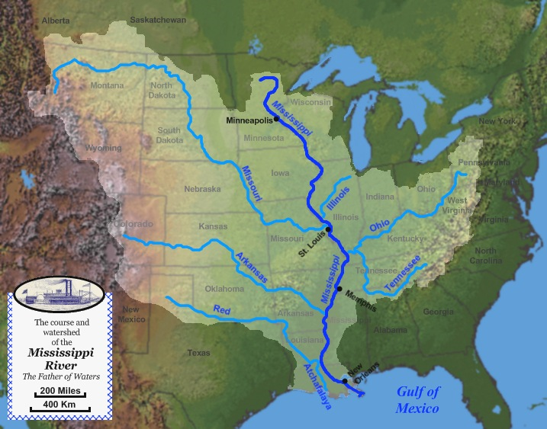

Slide 24
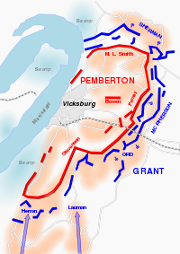
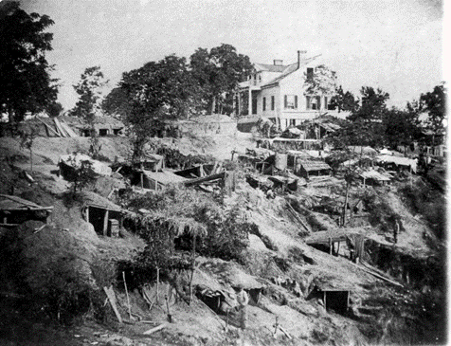
Siege of Vicksburg

Slide 25
Northern Fatigue
Attitudes towards the war begins to sour in the North
Price of goods raises due to shortages in the work force
1862: $18 for a pair of shoes
1864: $800 for a pair of shoes
Lincoln, desperate for more men, institutes the first draft in American history.
Draft: forced service in the army
Riots break out in New York City out of protest to the draft
Biggest riot in American history
Many people in the North start talking about ending the war due to the high death rates.

Slide 26
Civil War Medicine
The high casualty rates forced a revolution in battlefield medicine
More deaths from diseases than battle
High rate of infection of wounds
Women now involved in nursing profession
Clara Barton

Slide 27
Battle of Gettysburg
Trying to seize the momentum and end the war, Lee once again tries to invade the North
Lee is met this time by General Meade at Gettysburg, PA for what will be the biggest and most important battle of the war.
For 2 full days, Lee sent attack after attack to the Union lines

Slide 28
Battle of Gettysburg
On the 3rd Day, Lee decided to attack one last time, committing 12,000 men of his army in a charge at the center of the Union Forces
Pickett’s Charge: The Rebel army was devastated by cannon fire and minie balls almost broke the lines but was pushed back
“High Water Mark of the Confederacy” Lee and the CSA will NEVER come so close to victory again

Slide 29
Battle of Vicksburg
The day after Lee’s defeat and retreat from Gettysburg, Grant takes the Confederate city of Vicksburg, giving the USA control of the Mississippi
Cuts the CSA in half, denying them invaluable supplies
Lincoln, upset that Meade didn’t destroy Lee, replaces him and puts Grant in command of the entire Union Army.

Slide 30
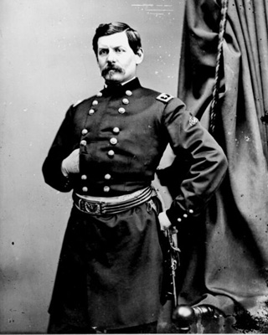
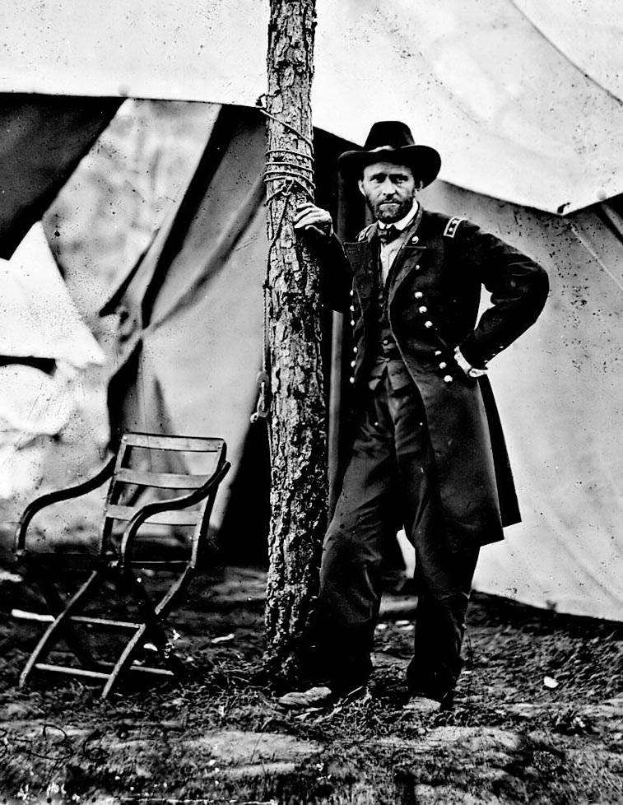

Slide 31
Grant’s End Game
Grant realizes that he needs to use the strength of the Union’s superior numbers and supplies to his advantage
The North can replace men and weapons, while Lee can’t.
Meets Lee in a number of battles where he suffers heavy losses, but the South’s losses are irreplaceable
Heavy losses make it clear Lincoln will lose reelection in favor of peace candidate
Battle | Union Casualties | Confederate Casualties
Wilderness | 18,400 | 11,400
Spotsylvania | 18,000 | 12,000
Cold Harbor | 12,700 | 4,600

Slide 32
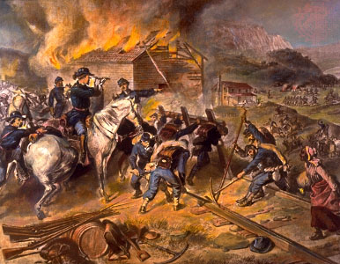
Grant’s End Game
With Grant pounding Lee into submission in the east, he orders William T. Sherman to end the war in the west
Sherman advances to Atlanta and burns it to the ground
Total War: tactics designed to completely destroy the enemy: their army, resources, and will to fight
March to the Sea: Sherman continued to burn crops, towns, railroad tracks, etc
Sherman’s success guarantees Lincoln’s reelection after many in the North were wanting to sue for peace
“War is Hell”

Slide 33
Sherman Bowties

Slide 34
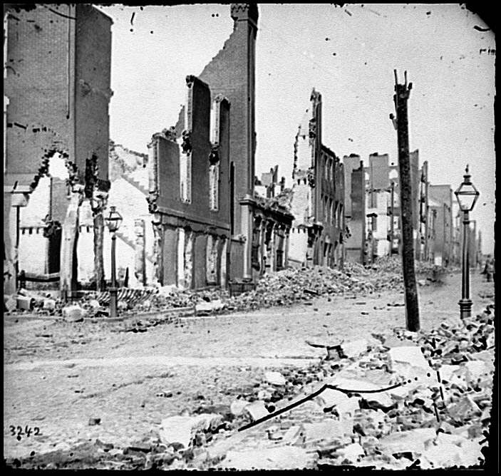
IS TOTAL WAR ACCEPTABLE?

Slide 35
Appomattox
Plagued by lack of men, supplies, and beat into submission by Grant’s superior numbers, Lee is finally trapped and forced to surrender his army, effectively ending the war at Appomattox Courthouse in April 1865, four years after Fort Sumter
Doesn’t advocate continued resistance and guerilla war as many feared, but rather peaceful reconciliation with northerners and former slaves
Influenced many southerners to end the struggle

Slide 36
Effects of the War
CSA: 260,000 men killed
USA: 360,000 killed
Over half a million Americans!
Half a million more wounded, crippled, etc.

Slide 38
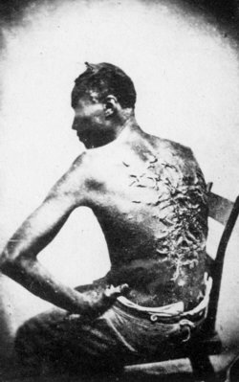
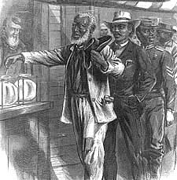
Effects of the War
Nation is reunited
South is destroyed economically, politically, and socially but is a part of the USA again
Slavery is over
Freed Africans now have same rights and freedoms as white Americans with the passage of the 13th -15th Amendments

Slide 39
Lincoln is Assassinated
Lincoln
1860
Lincoln
1865

Slide 40
Lincoln Assassinated
Lincoln, relaxing after 4 brutal years of war, and planning for the reconstruction of the south, was killed by John Wilkes Booth, a southern sympathizer who planned large scheme to assassinate all of the leaders of the US to let the CSA regroup in the chaos
Illustrates that road to reconstruction is going to be difficult for both sides

