Slide 1
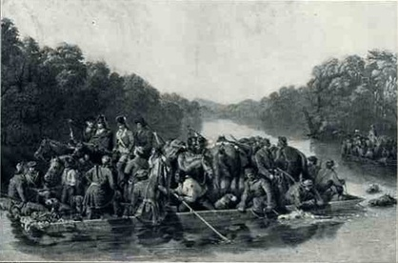
The War
Moves South

Slide 2
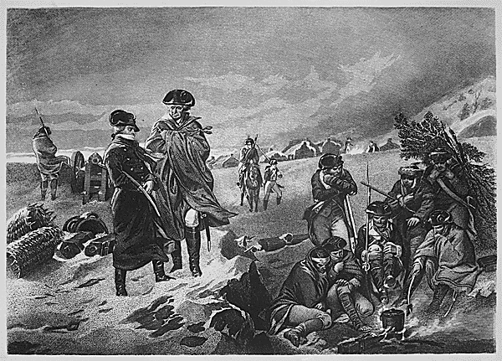
Northern War
Up to this point, the war had been concentrated in New England or the Middle Colonies
War had stalemated
British can’t destroy Washington’s army, more professional following Valley Forge and Von Steuben’s training
Washington can’t beat the British and Hessians

Slide 3
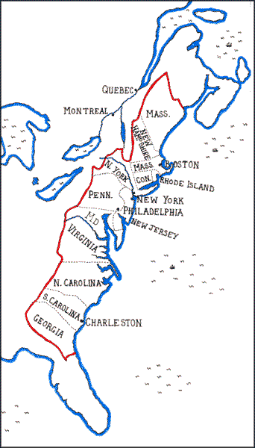
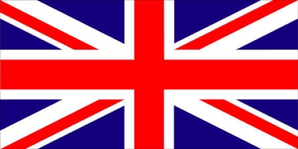
War in the South
Trying to end the war quickly, the British army moves towards the southern colonies
More loyalists
More slaves
Early successes
Take Charlestown
7,000 soldiers forced to surrender in largest defeat for the US
Take Savannah

Slide 4
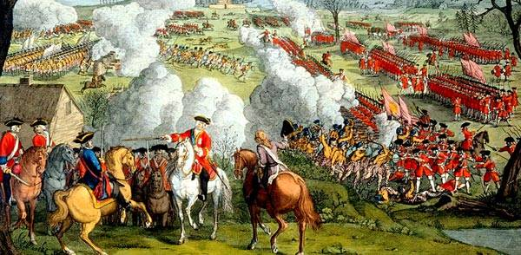
War in the South
British army under General Charles Cornwallis crushes the American army under the ‘hero’ Gates at Battle of Camden
Official American resistance in the south is eliminated
Nothing appears to stop him on marching up and trapping Washington

Slide 5
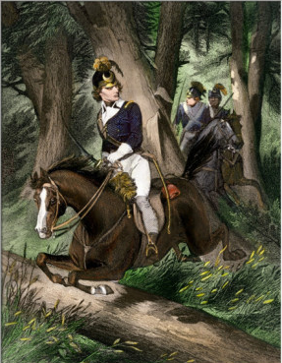
War in the South
However, Cornwallis march to the north was stalled by American guerillas
Francis Marion the “Swamp Fox” and others use their knowledge of the terrain in their guerilla attacks
War adopts ‘civil war’ nature as most of fighting is against loyalist Tories
Buys time for Americans to regroup

Slide 6
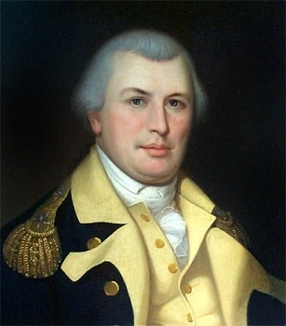
Greene Runs and Fights Again
Washington sends his most trustworthy aide, General Greene to go and face Cornwallis
Greene knew he could not stand up to Cornwallis in a fight so he made Cornwallis chase him through the Carolinas
In order to keep up, Cornwallis had to dump all of his supplies
At the end of the chase, and a few battles, Cornwallis was left with a tired and ill supplied army
Had to move to the coast to get reinforcements

Slide 7
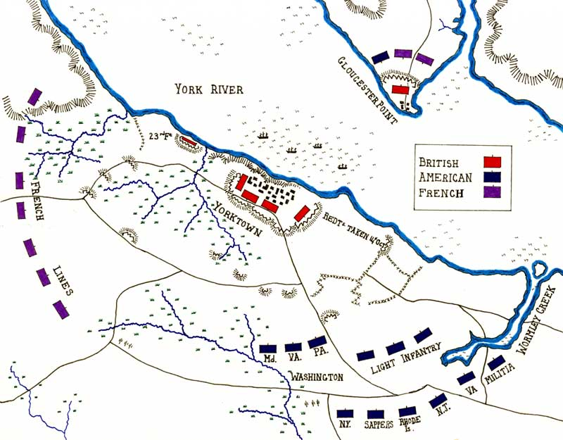
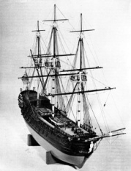
Battle of Yorktown
Washington sees opportunity
Sneaks his better trained and equipped army as well as French allies down to meet Cornwallis
French navy also arrives on the sea
Describe the situation Cornwallis is in.
Cornwallis is Trapped!

Slide 8
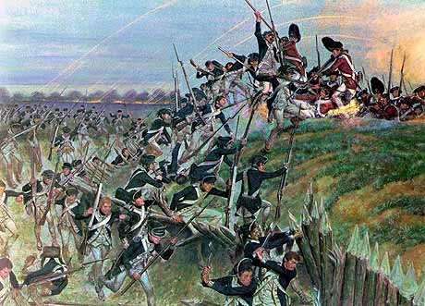
Battle of Yorktown
20 day long siege of British fortifications
Americans and French bombard Cornwallis’ troops by land while French navy was there to prevent any escape or reinforcements that might come to Cornwallis
Finally Cornwallis surrendered his entire army to Washington
“World Turned Upside Down”

Slide 9
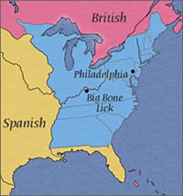
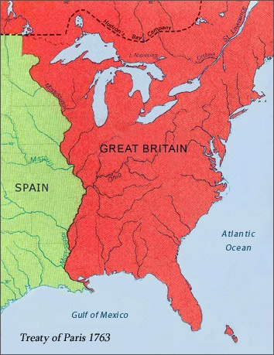
Effects of Yorktown
Yorktown was the last major battle of the American Revolution, although the war did not officially end until two years later in 1783 with the signing of the Treaty of Paris
Long and costly war is increasingly unpopular in Britain
Britain finally recognizes independence of the USA
US gets all British lands from the Atlantic to the Mississippi River
USA

