Slide 1
Bell Ringer 8/20
One thing I already know about the American Revolution is________________. The thing that I don’t understand about this conflict is _______________________.

Slide 2
Road to the Revolution
French and Indian War
Pontiac’s Rebellion
Proclamation of 1763

Slide 3
Cause of the Conflict
As the British colonies grew, they expanded into territory claimed by France.
Each nation wanted to control the continent
Rivers and Lakes were crucial to control territory.

Slide 4
Washington and Start of the War
Virginia government sent young George Washington to claim land in western Pennsylvania for Britain
There, he found and attacked a small group of French troops. He is quickly defeated by a larger French retaliation
Britain declares war on France

Slide 5
French and Indian War
Natives are going to prefer French to English
French work with natives to get furs
English create farms, taking more and more native land

Slide 6
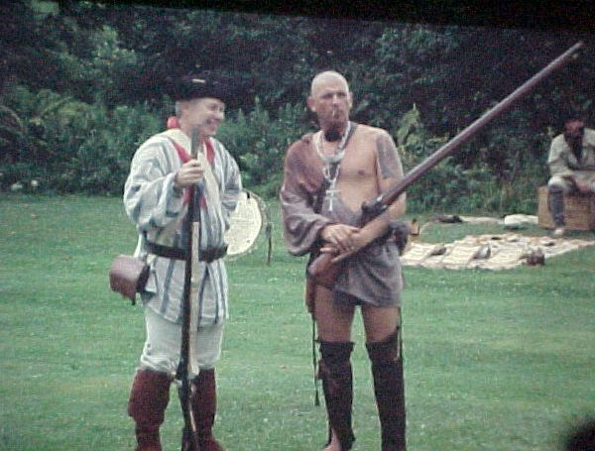
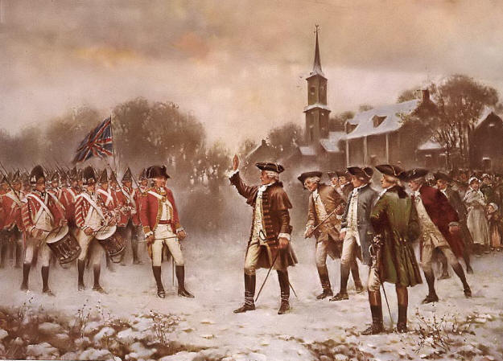
REMEMBER!
French and Indians
VS
British Army and Colonists

Slide 7
British style of warfare included marching in straight lines against an enemy in a large open field
Warfare where technology, numbers, and experience of soldiers mattered most

Slide 8
Is this ground good for this type of fighting?

Slide 9
Hit and run style ambushes, the way natives fought, is much more efficient in this terrain

Slide 10
British struggled early in the war as a result
Didn’t trust colonials
Suffered many defeats by the French and their native allies

Slide 11
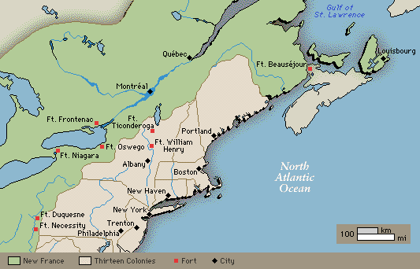
British Turn the Tide
The British start winning the war after they begin to rely on their navy
Allowed them to control the reinforcements and supplies the French and their native allies received
They could also use major waterways to attack the French at their major cities
Naval strength CRUCIAL during war.

Slide 12
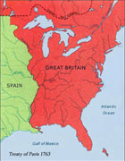
Afterwards…
France asks for peace
Treaty of Paris officially ends the war
France gives up all land in North America to England
Spain, which allied with France, gives up all land east of the Mississippi River

Slide 13
What other ally of the French is going to lose out?

Slide 14
Effect on Natives
With the French gone, the natives have lost their best ally in allowing them to hold on to their lands

Slide 15
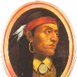
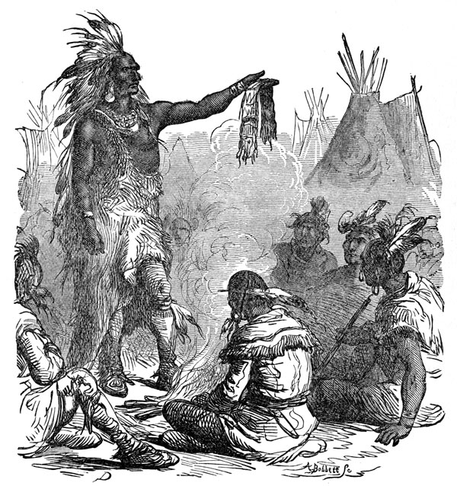
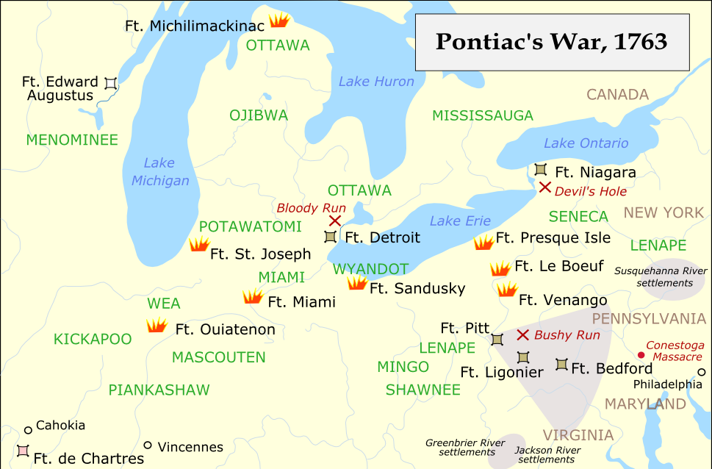
Pontiac’s War
Natives under Ottawa chief Pontiac continued to fight, attacking and destroying British forts along the frontier
2,000 settlers are killed
British army are able to put down the rebellion
Had to keep huge number of troops west of mountains
Made British see that natives are going to be a problem

Slide 16
Effects of Pontiac’s Rebellion
After seeing the destruction and cost of Pontiac’s War, it made the British see that keeping peace along frontier was going to be a an expensive process
How could you try to keep the peace between settlers and the natives?

Slide 17
Proclamation of 1763
British government banned expansion west of the Appalachian Mountains
Can’t fight if they’re not by one another

Slide 18
Colonial Reaction to Proclamation
Colonials didn’t think it was fair
Just fought a bloody war for that land
Continued to go into rich lands to the west
Law was impossible to enforce

Slide 19
Debt
One of the most important effects of the French and Indian War was Britain was left with a huge debt.
Wars are extremely expensive

Slide 20
How to Pay off this Debt?
British feel that since the war was fought in large part to protect colonists or get more land for the colonists they should help pay the costs through taxes
Does this sound fair?

Slide 21
How to Pay off this Debt?
Colonists disagreed
English Bill of Rights says that you can not be taxed without permission
Permission is given through consent of Parliament
Colonists had no representatives in Parliament
“No Taxation Without Representation”

