Slide 1
Rise of Sectionalism
North vs. South vs. West

Slide 2
Era of Good Feelings
Following the victory in the War of 1812 and the passage of the Monroe Doctrine, Americans have a true sense of pride in themselves and their country.
Nationalism- feelings of pride and loyalty to the nation
Rapid expansion westward
Economy is booming
Markets in Europe open for US products
Party fighting stops
Monroe runs for reelection unopposed
Era of Good Feelings

Slide 3
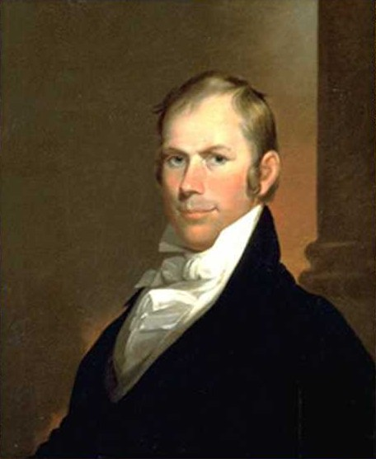
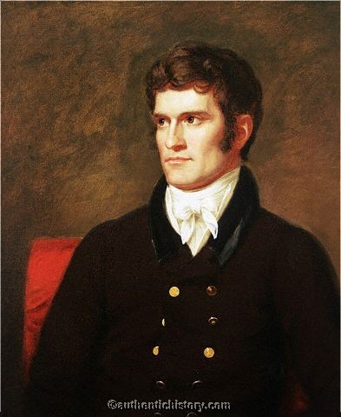
Sectionalism and its Leaders
Monroe would be last of the ‘revolutionary’ generation.
Policy would now be dictated by a new group of leaders, who had grown up in the new nation (War Hawks)
“Great Triumvirate”
John C. Calhoun
Daniel Webster
Henry Clay

Slide 4
Sectionalism and its Leaders
Each of these young leaders worked to promote their own individual area of the nation
Webster: the North
Calhoun: the South
Clay: the West
Sectionalism- preference for a particular region of the nation over the nation as a whole.

Slide 5
The North
More industrial than the other regions of the nation, the north becomes further reliant on manufacturing following the Industrial Revolution
Using power sources like:
Coal
Steam
Water
to power machines to make goods

Slide 6
Changing Landscape
New England was perfect for factories since it already had resources to fuel machines
Coal
Timber
Iron
Rivers
Also built series of canals to divert waters to power factories

Slide 7
Urbanization and Immigration
These factories led to a change in the characteristics in the North
Larger parts of the population moved into cities looking for jobs
Immigrants from Europe settled here to find work in the factories (German and then Irish)

Slide 8
The South
Since the colonial era, the Southern economy was dominated by plantations (which depended on slavery)
The Founding Fathers, despite not liking slavery, allowed for it to continue in the Constitution. Why?
They thought the institution of slavery was dying,
it was unprofitable to own slaves

Slide 9
Eli Whitney and the Cotton Gin
Slavery was on the way into extinction until inventor Eli Whitney came up with the cotton gin, which allowed for cotton to be processed very quickly.
Cotton quickly becomes the most important crop and export in the south
‘King Cotton’
¾ of world’s cotton
Production doubled every decade

Slide 10
Growth of Slavery
Since cotton is easier to process and becomes so profitable, a larger labor source is needed to pick the crop.
The Cotton Gin is responsible for revitalizing the slave system
1/3 of southerners were slaves
Most southerners did not own slaves

Slide 11
The West
Agriculture based, but not the massive plantation society that existed in the south
Soil and weather not suited for it
More individual family farms
What do you think these farmers would be most concerned with?

Slide 12
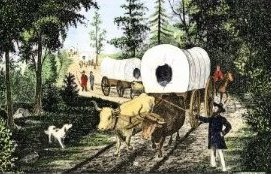
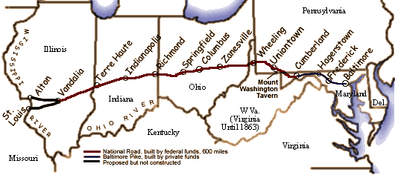
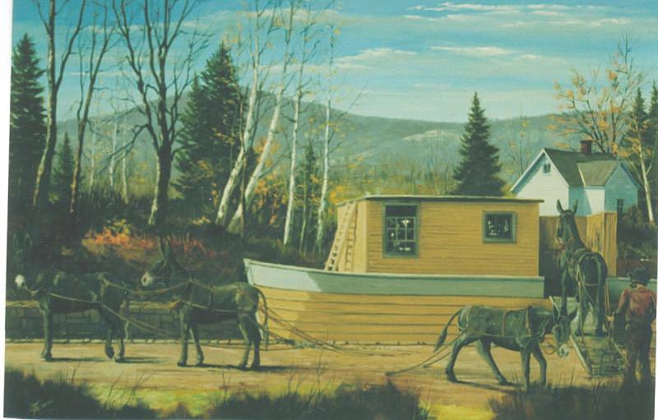
Transportation
Westerners were most adamant about the government improving the life of these farmers
Making land available for cheap prices
Removing natives
Improving transportation systems to ease transport of crops to market
Canals
The Erie Canal linking NYC with the Great Lakes being the most famous
National Road

