Slide 1
Age of Jackson

Slide 2
Voter Suffrage
In addition to other social movements and changes that were created in the 1820s was increased voter suffrage and how officials were elected.
Suffrage: the right to vote
By the 1820s, most states had repealed requirements for voters had to own a set amount of land was now repealed
Many allowed all white males to vote
Women and minorities still heavily restricted
Rise of nominating conventions
Party members, not just leaders, chose candidates
What sort of individuals do you think are now going to be able to vote that hadn’t had the opportunity before?

Slide 3
Voter Suffrage
With increased suffrage, nature of elections changed
Voting no longer reserved for elite
Rise in western farmers and factory workers
Campaigns and elections became social events
Candidates were actually forced to campaign and appeal for votes

Slide 4
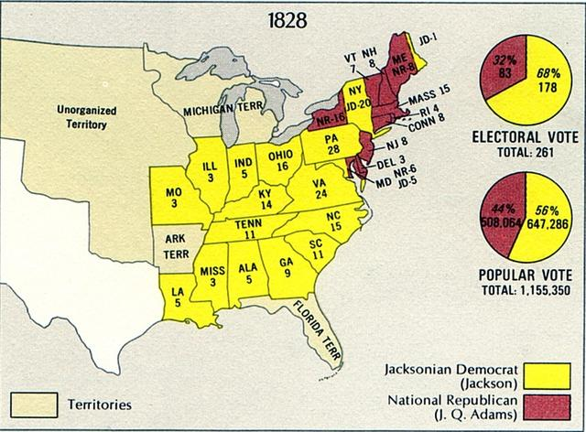
Rise of Jackson
This increase of suffrage corresponded with the rise of War of 1812 hero Andrew Jackson
Narrowly lost the election of 1824
Corrupt Bargain?
No actual evidence
Landslide victory in 1828
After the DIRTIEST election in U.S. History
Rachel Jackson died from the slanders
Saw his election by such a huge margin as a mandate from the people to stand up for the common man.
Large support came from the western and southern states

Slide 5
Jackson’s Inauguration
Presidential inaugurations had usually been formal affairs, but Jackson as the champion of the common man opened it up to everybody.
Huge party at the White House
“It was the People’s day, and the People’s President, and the People would rule”

Slide 6
Spoils System
As president, Jackson rewarded his supporters
“To the victor belong the spoils”
First action as chief executive included replacing many federal government workers with Jackson supporters
Pro: More democratic
Con: Removing qualified and experienced civil servants
What do you think is more important?

Slide 7
Jackson as President
Created the modern day Democratic Party.
Those that opposed Jackson were divided into multiple smaller parties.
Jackson was a fighter and would spend his presidency fighting various:
Individuals: ___________
Groups:______________
States:_______________
Institutions:___________
Earned him the nickname “King Andrew the First”
Saw himself as the TRUE representative of the American people

Slide 8
Jackson vs. Calhoun and the South
People from which section of the nation were opposed to a high tariff? Why?
Southerners HATED a high tariff since, as farmers, they imported most of the manufactured goods they needed and would have to pay a higher price as a result.
$

Slide 9
Jackson vs. Calhoun and the South
Nullification Crisis
In 1828 and 1832, Congress tried to pass high tariffs
South Carolina, led by Vice President John C. Calhoun claimed that states had the right to nullify federal laws and if they were refused this right then they could secede from the Union
Nullify: cancel, void
Secede: withdraw, leave
Unionists, led by Daniel Webster, argued that the Constitution stipulated that the federal government is supreme
Supreme Court ruling on McCulloch v. Maryland reinforced federal supremacy

Slide 10
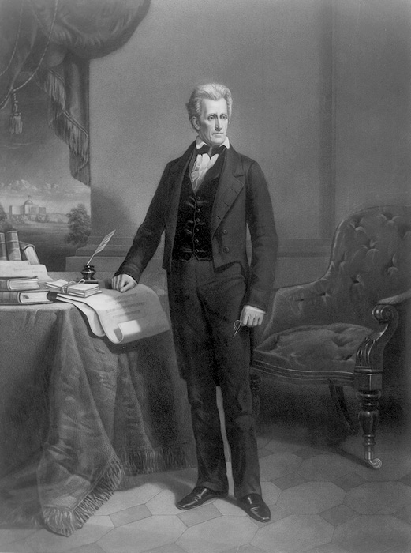
What do you think Jackson, a southerner, will do?

Slide 11
Jackson vs. Calhoun and the South
Despite his southern ties, Jackson was a strict Unionist
Jackson: The Constitution says that laws of the Federal government were superior to actions of the states
Said that secession was treason
He threatened to march an army down to South Carolina and personally hang Calhoun from the first tree he saw.
Calhoun resigned as V.P.

Slide 12
Jackson vs. Calhoun and South
Henry Clay, the Great Compromiser, came up with a solution
Jackson can pass a bill that would allow the Federal Army to use force against S.C.
Lowered the tariff
At this time, South Carolina can not get support from other southern states to threaten to secede so they back down
Crisis is averted, but illustrated that some southern states would be willing to leave the Union.

Slide 13
Jackson vs. National Bank
After the War of 1812, another national bank was created to provide more stability and deal with debt
2nd Bank of the U.S.
Intense feelings for and against the bank formed.

Slide 14
Differing Attitudes Towards the Bank
Pros
Cons
Makes loans to merchants and manufacturers
Backed up smaller banks, making people trust them.
Stable currency
Safe place for the federal government to place their funds
Restricted loans smaller banks could make
Farmers wanted more loans available to them
Spent national funds
Bank leaders were not elected
Had too much control of the economy
Which side do you think President Jackson will be on? Why?

Slide 15
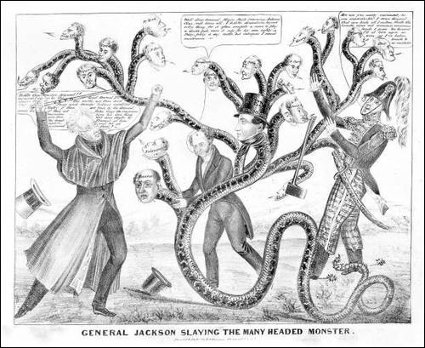
Jackson vs. National Bank
“You are a den of vipers and thieves. I intend to rout you out, and by the eternal God, I will rout you out.”

Slide 16
Jackson vs. National Bank
Jackson was violently opposed to the National Bank
Saw it as hurting the ordinary individual
Especially his main support group- Western farmers
Vetoed bill to renew the bank.
Won him reelection in 1832 over Henry Clay
Removed all federal funds from the bank and gave them to smaller state banks
Eventually lead to a depression, since all of these banks made loans without restraint.

Slide 17
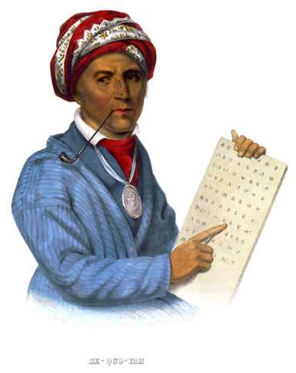
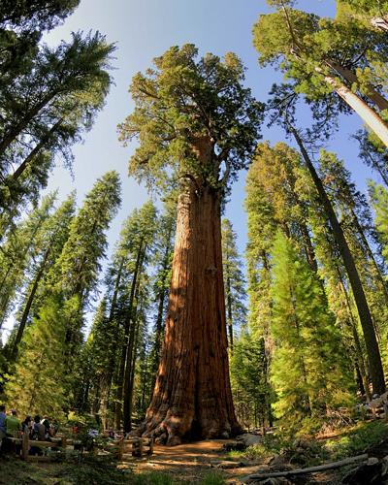
Jackson vs. Cherokee
By the time Jackson came to office, there were approximately 100,000 Native Americans living east of the Mississippi River.
5 Civilized Tribes in South
Cherokee
Adopted many American customs: farmed, adopted American dress, ruled by a written Constitution, owned slaves, only tribe to convert their oral spoken language into a written form

Slide 18
Jackson vs. Cherokee
The Cherokee owned, by federal treaty, large parts of fertile land in Alabama, Tennessee, North Carolina, and Georgia.
What was this land great for? What was ‘king’ in the south?
This land was ideal for growing cotton.

Slide 19
Jackson vs. Cherokee
Georgia passed a law that stated that the Cherokee must sell their land and move
Since the rights of the Cherokees were being violated, what would the ‘civilized’ response be?
The Cherokee Nation sued the state of GA and took them to the Supreme Court
Worchester v. Georgia

Slide 20
Jackson vs. Cherokee
Supreme Court agreed with the Cherokee!
What does Jackson have to do now? What is his job as the chief executive?
Jackson angry with the result.
Wanted to support the farmers in the west and southern sections
“Judge Marshall has made his decision, now let him enforce it.”

Slide 21
Jackson vs. Cherokee
Instead of enforcing the ruling of the Supreme Court, Jackson passed the Indian Removal Act
Allowed Jackson to trade the natives lands west of the Mississippi River in the “Indian Territory” for their ancestral lands in the East
70,000 Natives were forcibly moved from their homes and forced on foot westward

Slide 22
Trail of Tears
18,000 Cherokees were forced to make the 800 mile journey mostly by foot through terrible conditions
Not adequately supplied by Jackson’s government
25% die en route

Slide 23
Jackson Retires
After serving his two terms, Jackson retires
Increased ordinary citizen’s role in the federal government
Created the modern Democratic Party
Continued western expansion
Upheld and defended federal authority
Increased the power of the President, illustrated that they could be the main policy maker

