Slide 1
Revolution of 1800

Slide 2
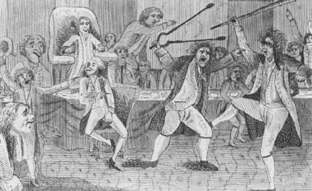
End of Federalist Era
What Act passed by the Federalists angered huge parts of the population (especially the Democratic- Republicans)? Why did they pass this law?
The Alien and Sedition Acts made it illegal to speak negatively against the President or the government in general
The Federalists were very unpopular coming up to the election of 1800.

Slide 3
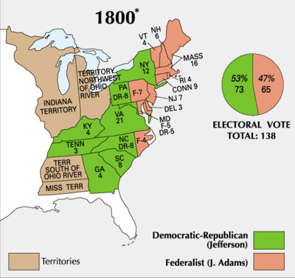
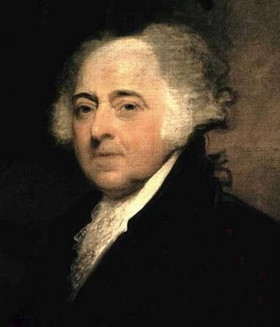
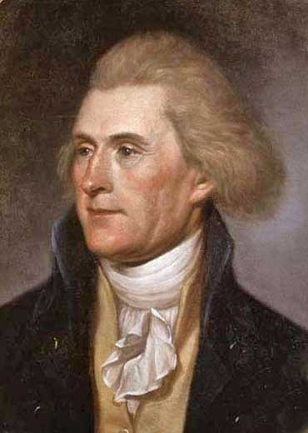

Slide 4
“Revolution” of 1800
Jefferson and the Democratic-Republicans take control of the Federal government.
What is unique about this transfer of power?
It is the first time ever, that power is exchanged peacefully between two opposing groups.

Slide 5
“Revolution” of 1800
Jefferson started to enact a set of policies different from the Federalists
What do we know about Jefferson’s feelings towards a large federal government?
“A government big enough to give you everything is big enough to take everything you have.”
T. Jefferson
We know Jefferson is going to want to limit the authority of the Federal gov.
Laissez faire: (hands off) government

Slide 6
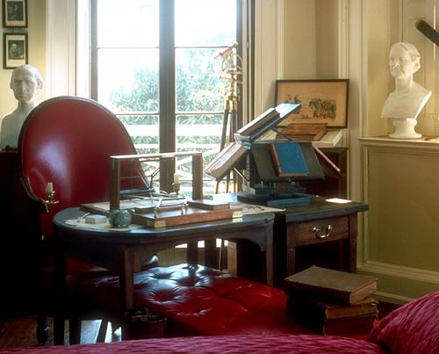
Reduce Federal Power
Decrease size of military
No taxes
Repealed Alien and Sedition Acts
Cut number of federal employees

Slide 7
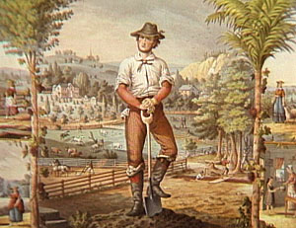
Rise of the Common Man
Jefferson criticized the Federalists from being too close to monarchy of Great Britain, and he wanted the nation to go back to being for the common man
Wanted a nation of small farmers
Jefferson himself:
Shaking hands
Answering the door in his pajamas

Slide 8
Ease Tensions
Election of 1800 marked the end for the Federalists, but Jefferson wanted to decrease tensions
Continue Hamilton’s policies
Keep the National Bank
Tariffs (scaled back)

