Slide 1
Problems with the Articles

Slide 2
Under the Articles of Confederation, what group had the majority of the power? Why was it set up this way?
The states had the power since we were afraid of putting too much power into one big government.
They didn’t want to be like the British at all!

Slide 3
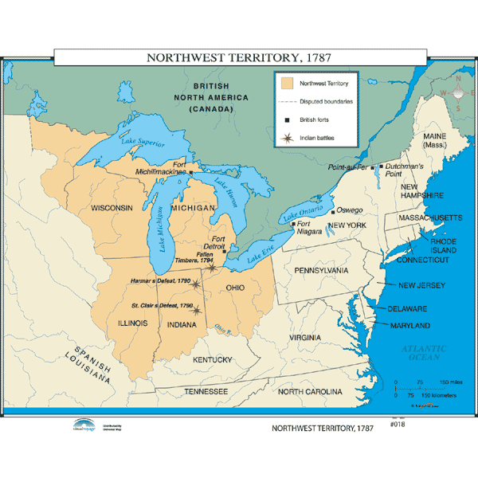
Articles of Confederation
Articles of Confederation had worked well early
Won the war
Admitted new lands into the nation
The states cooperated with one another at times
What were some of the limitations of the Articles of Confederation?

Slide 4
Problems with the Articles of Confederation
Structure
Federal government consisted of 1 legislative body
No federal executive
Couldn’t enforce its laws
States could choose not to follow laws it disagreed with
It took a super majority to pass a law
States were unwilling to work together when there was not a threat
Federal Government
Power

Slide 5
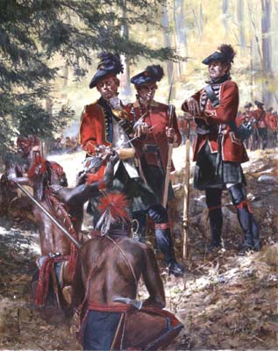
Problems with the Articles of Confederation
Foreign Relations
Despite the Treaty of Paris, British refuse to leave forts in the West
Why wouldn’t they leave?
Federal government can’t force the British out
No army
No funds to support one
States control militia and were unwilling to send them out of their borders

Slide 6
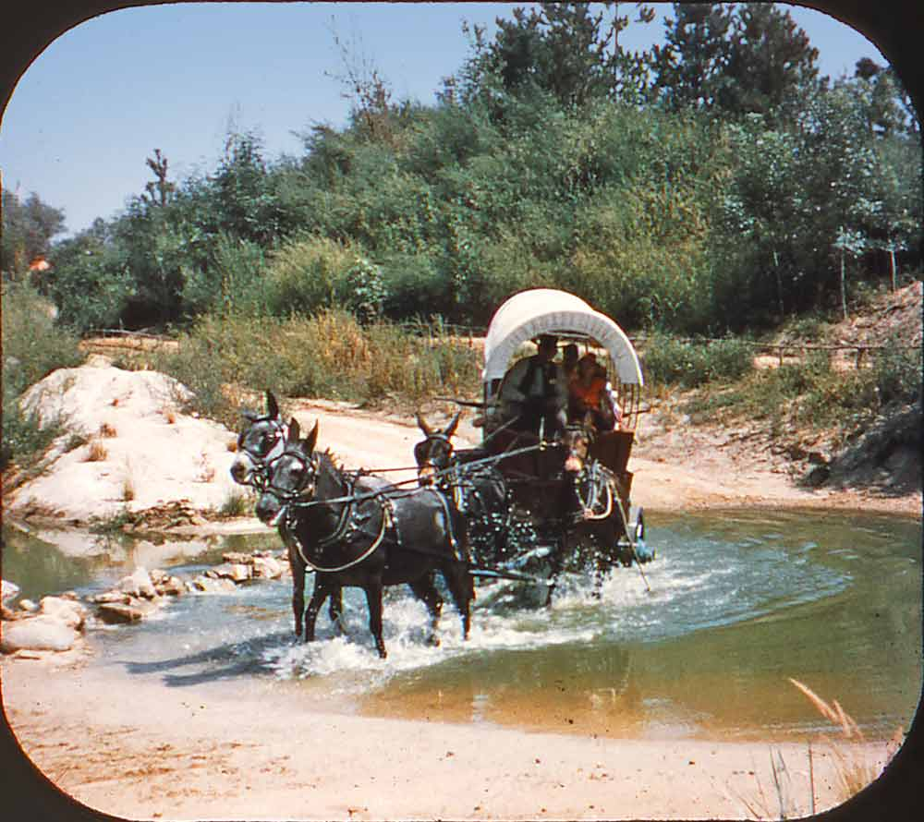
Problems with the Articles of Confederation
Economic
Federal government couldn’t collect taxes
Had to beg states for funds
Couldn’t support military, construct building projects, etc.
States regulated trade
States put up high tariffs (taxes)on goods from other states which made them more expensive
States printed their own money
Trade between states declined

Slide 7
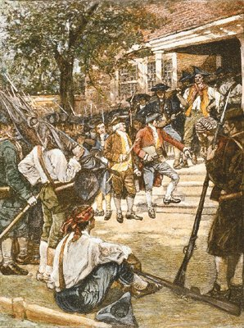
Shays’ Rebellion
In mid 1780s, a depression set in the U.S.
Why?
Trade between states became near impossible
Farmers were unable to sell their goods
Banks began to take the farms who couldn’t pay back their loans

Slide 8
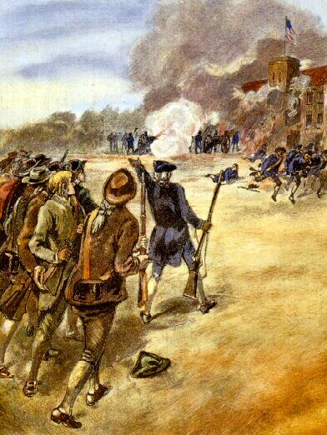
Shays’ Rebellion
Thousands of farmers rally to Revolutionary War veteran Daniel Shays to march on banks and courts to prevent foreclosures
Militia eventually puts down rebellion
Got people’s attention that things need to change in America

Slide 9
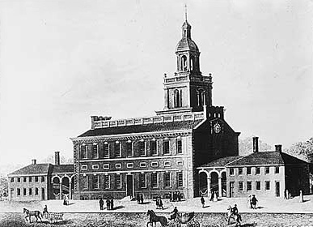
Amend Articles
States send leaders to Philadelphia in 1787 to amend and fix the Articles, but they are going to end up creating a whole new document.

