Slide 1
Monroe Doctrine

Slide 2
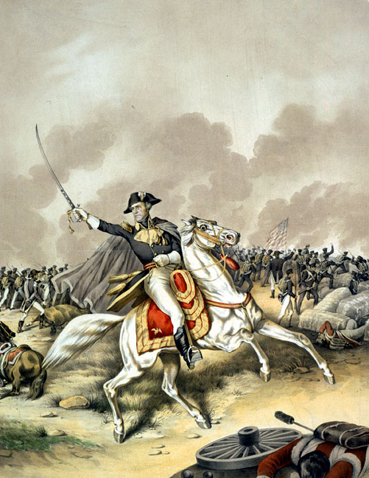
Following the War of 1812…
Americans feel extremely proud of themselves following the victory in the War of 1812
Confirms US independence
Sense of American identity
Eliminated organized native resistance east of the Miss.
Spurred manufacturing
The conclusion of European wars create available markets for American goods and the U.S. experiences an economic boom
Lack of political fighting
Federalist Party is no more

Slide 3
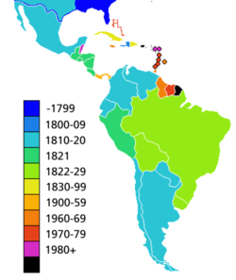
Revolutions in Spanish America
According to the map to the right, when did most nations of South and Central America gain their independence? What about that time do you think made this possible?
Many Spanish colonies broke away during the 1810-1820s since the fighting in Europe made it difficult for Spain to keep control over its large empire.

Slide 4
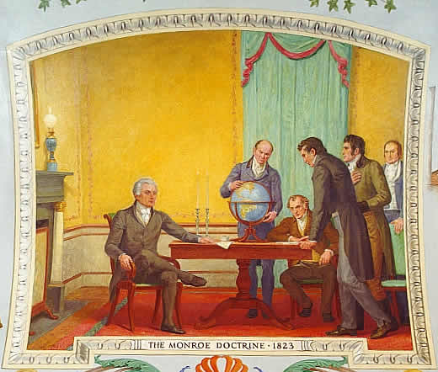
The Monroe Doctrine
American leaders were worried when France promised to help Spain regain its lost colonies
Didn’t like the possibility of European empires extending control of the Americas
Britain agreed with the U.S but only because with their advanced industry and large navy they wanted these areas open to trade

Slide 5
The Monroe Doctrine
Monroe introduced his doctrine, which would shape American foreign policy for nearly a century
Europeans are not allowed to settle any more colonies in the Americas
Europeans should not interfere with new nations
The U.S. will not interfere with any existing colonies or involve itself with the affairs of Europe
In your own words what does the document say to the European powers?

Slide 6
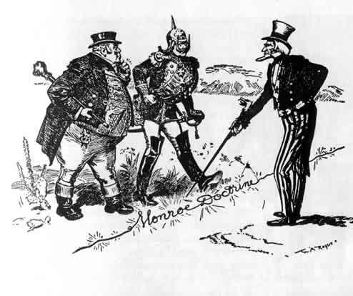

Slide 7
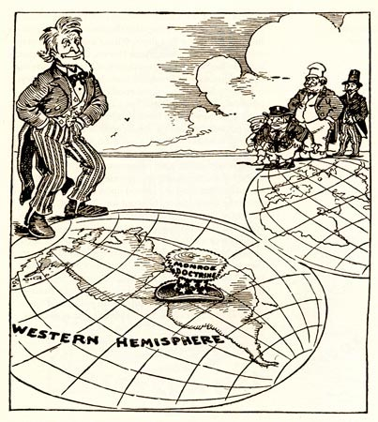

Slide 8
The Monroe Doctrine
Essentially, the Monroe Doctrine is telling the European powers that the US will be the controlling factor in the Western Hemisphere and they need to stay out!

