Slide 1
Missouri Compromise

Slide 2
Sectionalism
During the 1820s the nation was divided by sectionalism
What three distinct regions emerged?
Industrial North
Cash-Crop South
Small farm West
Each region wanted the federal government to pass laws that would benefit them

Slide 3
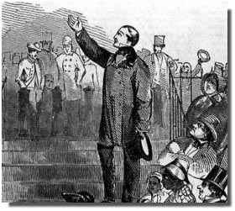
Abolitionism
Attitudes towards slavery in the north were changing.
More people were admitting that slavery was wrong
Quakers, Puritans, etc.
Some wanted to establish colonies back in Africa
“Liberia”
Some called for the immediate abolishment or abolition of slavery
Abolitionists
Slight minority that were seen as radicals

Slide 4
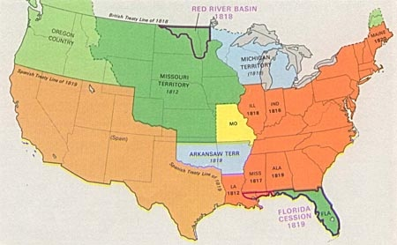
The Slavery Question
Most of the northern population however was content to let slavery continue in states where it already was.
BUT! They did not want slavery to extend into any more areas.
Is there a chance that the nation
is going to grow and add more states?

Slide 5
The Missouri Problem
Neither section, the north or the south (free and slave states) wanted the other to have more power in the Senate.
When Missouri, the first state carved out of the Louisiana Purchase, applied for statehood, it did so as a slave state
What would have happened to the balance of power?
Missouri’s admittance as a slave state, not only would have tipped the balance in favor of the south, it also would have set a precedent for allowing the spread of slavery into the west

Slide 6
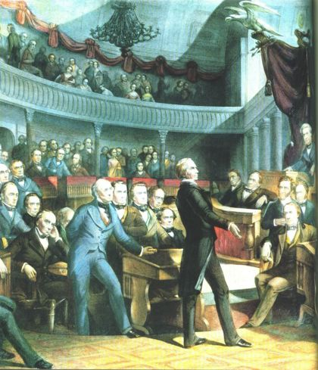
The Missouri Compromise
After an attempt by northern congressmen to ban slavery from the south, the nation looked as if it could come to armed conflict over the argument
Henry Clay “The Great Compromiser” came up with an agreement:
Maine would be granted statehood along with Missouri to keep the balance.
A line along the bottom of Missouri would mark where slavery would and would not be allowed.

Slide 7
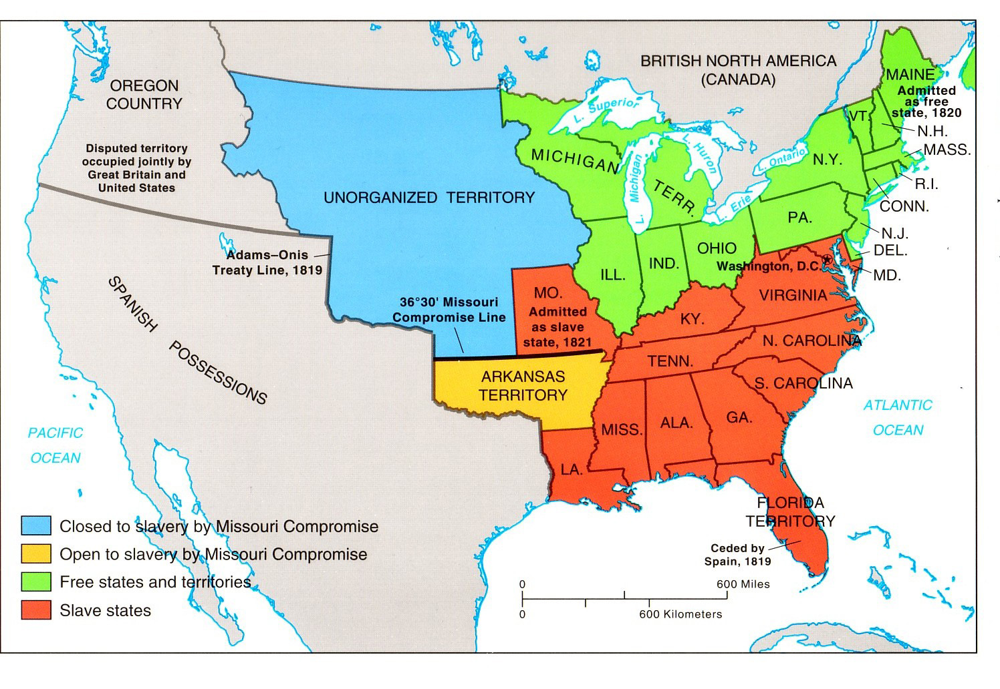

Slide 8
In the future, which section will have more states: those that are open or closed to slavery?
What can the other side to in response?
The South gets tougher fugitive slave laws to make up for lack of territory
Southerners will advocate for acquiring land from Spain.

Slide 9
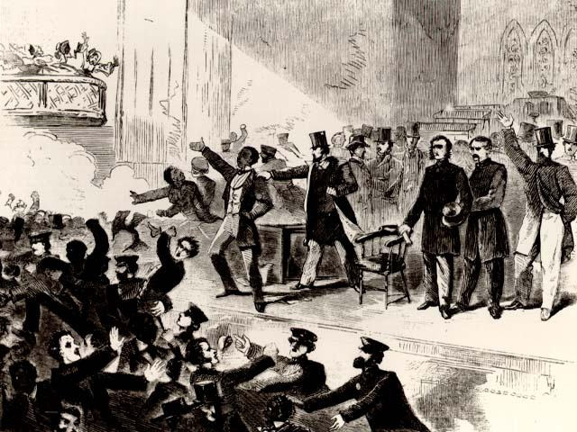
Effects of the Compromise:
Southern states, which always support a weak federal government and giving more authority to the states, are upset that the Federal government made the decision concerning slavery
Parts of the north were mad that slavery was allowed to expand to another state.
The Compromise did provide a temporary solution but it also clearly showed that the question of slavery was going to continue and be a source of conflict between the two regions.

