Slide 1
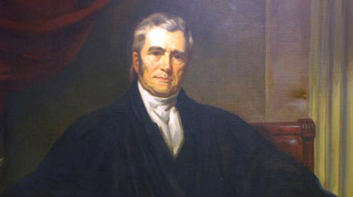
Marbury v. Madison and
Judicial Review

Slide 2
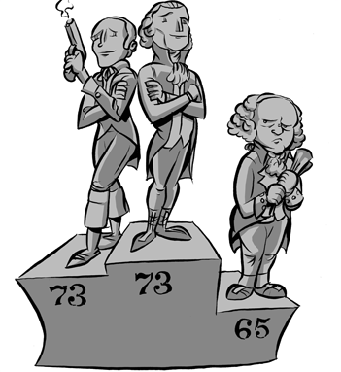
Revolution of 1800
Jefferson’s defeat of Adams and the Federalists was seen as a mandate return to the ‘ideals of the ‘76’
  Reduce power of federal government.
    Removed Alien and Sedition Acts
    Reduced size of the army
    Reduced taxes
    Reduced tariffs
    Removed Whiskey Tax
Clashed with the ‘undemocratic’ institution: Supreme Court

Slide 3
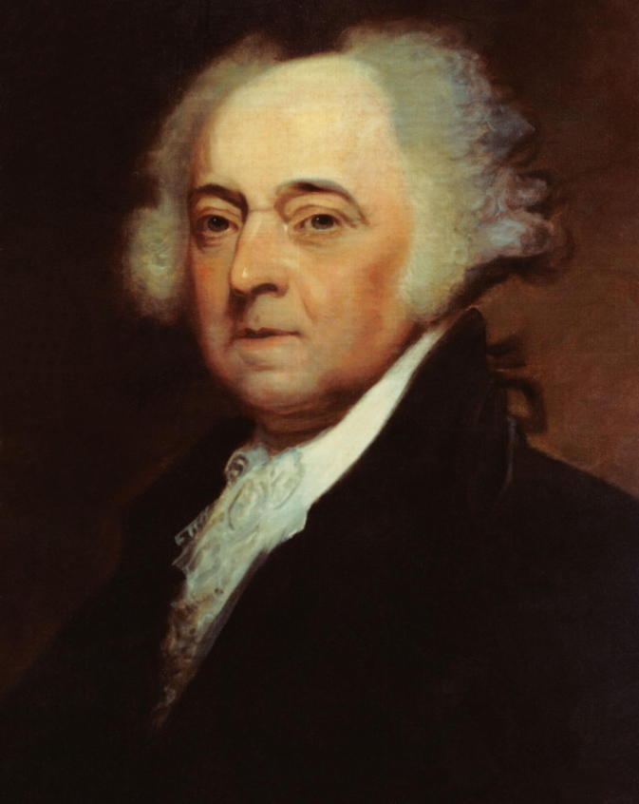

Midnight Judges
Before Adams left office, he appointed MANY federalist judges in an attempt to limit the changes Jefferson and the Democratic-Republicans would make
  “Midnight Judges”
    So many were made that not all of them could be delivered
      William Marbury did not get his appointment before Adams left office

Slide 4
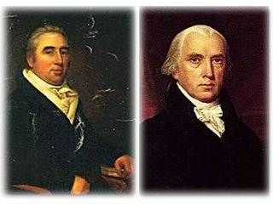
Marbury v. Madison
Thomas Jefferson tells his Secretary of State James Madison not to deliver the appointment to Marbury
  Marbury, citing the Judiciary Act of 1789, appeals directly to the Supreme Court to force Madison to deliver the job appointment

Slide 5
Questions before the Court
Question 1:
Does Marbury have a right to the Commission?
Question 2:
Did Marbury have a right to take the case to the United States Supreme Court?
(He did so because of the Judiciary Act of 1789)

Slide 6
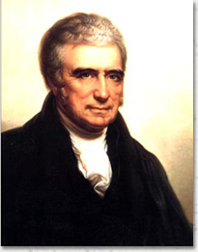
Marbury v. Madison
The Supreme Court, led by Chief Justice John Marshall, decided:
  YES Marbury had a right to the appointment
    Appointed by President
    Approved by Congress
  But…

Slide 7
Question 2: Does Marbury have the right to take the case to the Supreme Court?
Judiciary Act of 1789
The Supreme Court has original jurisdiction in this case.
US Constitution
Article 3:
The Supreme Court has original jurisdiction in specific cases only.
The Court ruled that Marbury could not sue directly to the Supreme Court and that the Judiciary Act was unconstitutional and couldn’t be enforced!
Court’s most important function was to uphold the Constitution

Slide 8
The Supremacy Clause
(Article VI, Section 2)
United States Constitution
If there is a conflict between a lower law and a higher one, the higher one “wins.”
Acts of Congress
State Constitutions
The U.S. Constitution is the “Supreme Law of the Land.”
State Statutes (laws)
City and County Laws
Notes:
Highlight the US Constitution as the highest law in the land and the concept of federalism.

Slide 9
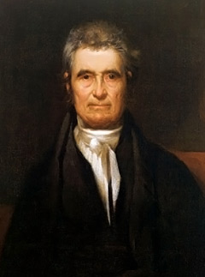
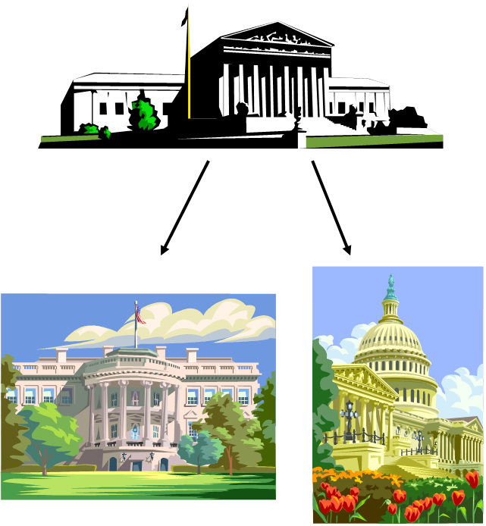
Judicial Review
Marshall’s ruling in Marbury v. Madison established several precedents for the Supreme Court
  Reinforced fact that the Court is NOT A POLITICAL BODY!
    Marshall and the other judges were all Federalists and they ruled against a Federalist
  Court has the right to review actions of the other two branches (Judicial Review) and determine if they are constitutional and can invalidate actions that aren’t
  Establishes Supreme Court as final authority on interpreting the Constitution and Judiciary as equals with the other two.
  “Great John Marshall”

