Slide 1
John Adams as President
Alien and Sedition Act

Slide 2
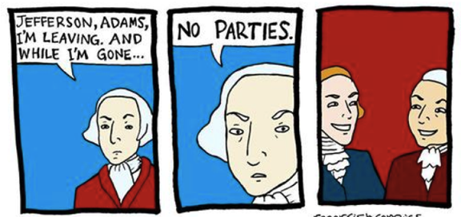
What advice does Washington give in his Farewell Address?
Based on the cartoon,
does the political leadership take this advice?

Slide 3
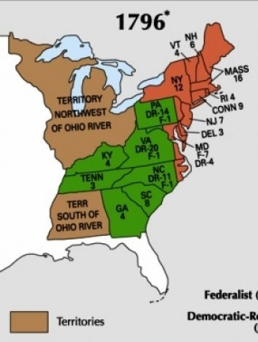
1st Party Election
Despite Washington’s warning, the election of 1796 was divided by parties
Feds: John Adams
D.R.: Thomas Jefferson
What regions do you think voted for each candidate?
Winning in the North and Middle States, Adams narrowly became the 2nd President of the United States, and Thomas Jefferson becomes Vice President

Slide 4
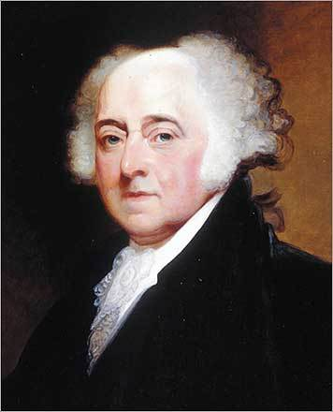
Adams as President
Foreign Policy:
France still upset about our neutrality and continue to seize our ships
Tensions worsen after French delegates get caught trying to bribe American diplomats (XYZ Affair)
Many Americans are calling for war with France
Overwhelmingly Federalists
Adams increases size of army and navy
Washington and Hamilton placed in command…reluctantly

Slide 5
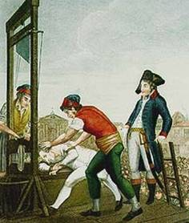
Alien and Sedition Acts
The Pro-British Federalists are fearful of French Revolutionaries entering America, and bringing the ‘reign of terror’ with them
Also thought the immigrants would support the Democratic-Republicans
Passed the Alien and Sedition Acts in response

Slide 6
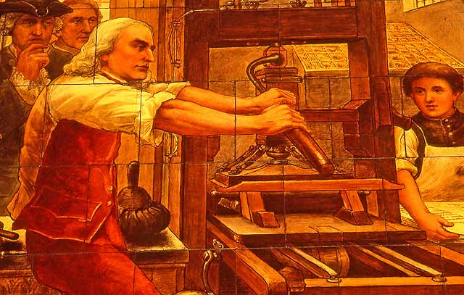
Alien and Sedition Acts
Under these laws:
Now harder to become a citizen
President can deport any immigrants (aliens) who are potential threats
Any negative comments made against the government or the President is seen as treason (sedition)
Many newspaper editors and a Senator (who happened to support the Democratic-Republicans) were arrested

Slide 7
The 1st Amendment protects Freedom of the Press!
Should President Adams have been able to do this? Why or why not?

Slide 8
Should the government be able to suspend personal freedoms in the goal of protecting the safety of citizens?

