Slide 1
Jefferson’s Embargo of 1807

Slide 2
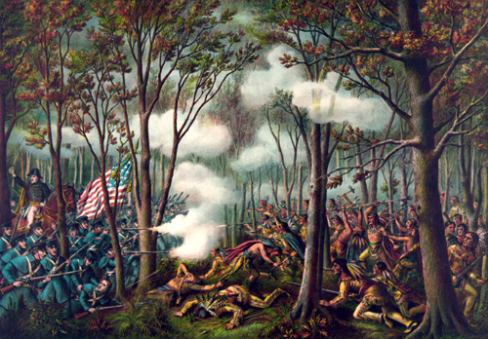
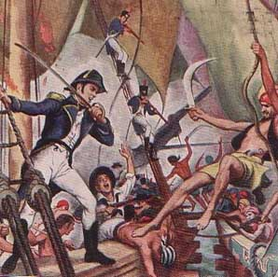
Unconventional Enemies
As discussed earlier, what sort of unconventional enemies did the early U.S. have no major difficulty dealing with?

Slide 3
Foreign Relations
The U.S. is going to find that dealing with well established nations like Great Britain and France is much more difficult.
The army and navy of America is not prepared or ready to take on the forces of these nations
These European powers were still fighting and taking American ships that were trading with the enemy

Slide 4
Impressment
The British also, desperate for more men to fight against Napoleon began impressing American sailors into their navies.
Impressment: kidnapping sailors and forcing them to serve
6,000-10,000 Americans were impressed into service

Slide 5
What can Jefferson do to stop these attacks since the use of force wouldn’t work?

Slide 6
Embargo of 1807
EMBARGO
Jefferson decided to go with economics to try to get European powers to stop interfering with our shipping
Embargo- government order that forbid foreign trade
Jefferson thought this loss of trade with the US to both nations would cripple their economies

Slide 7
Do you think this was a good solution? What side effects could the Embargo have?

Slide 8
Effects of the Embargo
Unfortunately for Mr. Jefferson, the nation that was hit hardest by the embargo, was the U.S.
France and Great Britain were able to trade with other nations.
As exports decreased ($109 million to $25 million), there was a surplus of goods, causing prices to drop, hurting farmers. Thousands of Americans lost jobs.
Impressment of American sailors continued!

