Slide 1
Jamestown
England’s 1st Permanent Colony

Slide 2
Bell Ringer 8/4
Identify the states:
A:
B:
C:
D:
E:
F:
A
B
C
D
F
E

Slide 3
Jamestown
King James of England gave a charter, permission to settle and establish a new colony, to the Virginia Co.
Why would the King want these joint stock companies to be formed?
So he could have access to new products and gain profit from taxing the company!

Slide 4
Jamestown
In 1607, 104 men landed on the coast of Virginia and established the 1st permanent English settlement in the New World, Jamestown.
Problems:
Settled in a swampy area
Exposure to mosquitoes brought on malaria and unhealthy drinking water caused dysentery.
Tensions with the natives
As with Roanoke fighting with the local Powhatan tribe erupted early on in Jamestown.

Slide 5
Jamestown
What problems do you think existed with the make up of the labor force of the colony?

Slide 6
Problems in Jamestown
The “Gentleman” class that made up the majority of the Jamestown population refused to do any work
Physical labor was beneath them
Wanted to spend time searching for gold
No farmers to grow food
Not enough doctors

Slide 7
What are going to be the effects of this system?
Not enough food!
By the end of the first winter, only 38 out of the original 104 are still going to be alive!

Slide 8
John Smith
John Smith rises to power and takes steps to correct problems with labor.
“He that works not, eats not”
Crops are planted
Natives are raided for food
Colony starts to get on its feet
Smith is injured and has to return to England.
What do you think the Gentlemen class will want to do once Smith is gone?

Slide 9
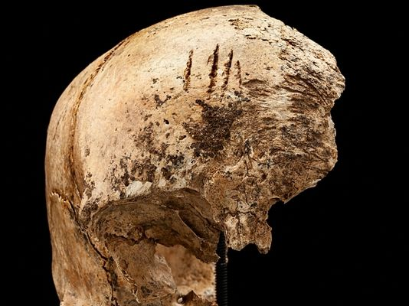
Starving Time
Without Smith’s guidance, colonists revert back to old habits
Crops aren’t planted
Expeditions for gold are sent out again and again
Natives retaliate
The winter of 1609 is known as the Starving Time
No food…..
Some colonists resorted to cannibalism
Of the 500 colonists in Jamestown, only 100 made it through the winter
Only a fresh supply of food and colonists from England saved the colony

Slide 10
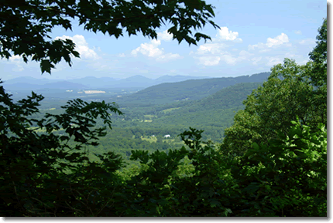
Salvation
If you were living in England, what would it take to motivate you to move to Jamestown?
To entice more settlers, the Virginia Co. promised 50 acres of land to anybody who would make the voyage to the New World
This was unheard of and impossible in England
Land was already all claimed
Little chance for social mobility
Many thought it was worth the risk

Slide 11
Salvation
Settlers were also willing to come following the discovery, by John Rolfe, of tobacco
Thrived in Virginia soil and climate
Huge demand in England
1 pound of tobacco was more expensive than a 1 pound of silver
Profits encouraged colonization and saved the colony

