Slide 1
Federalists vs. Anti-Federalists

Slide 2
Ratification of the Constitution
The delegates at the Convention signed and approved the document but in order for it to take effect, 9 out of the 13 individual states have to vote to approve it.
Two groups quickly developed, those who want to approve the Constitution and those who don’t.

Slide 3
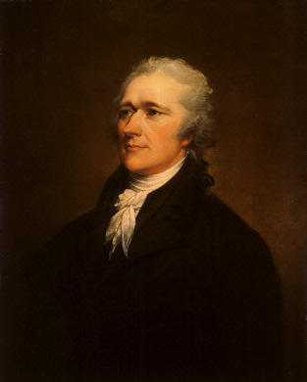
Federalists vs. Anti-Federalists
Federalists
Favored ratification
Thought that a strong federal government was needed
Thought any problems with the Constitution could be fixed once the federal government has the power to fix it
Lead by: James Madison and Alexander Hamilton

Slide 4
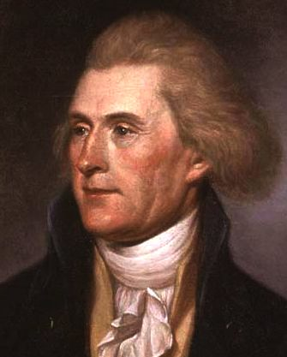
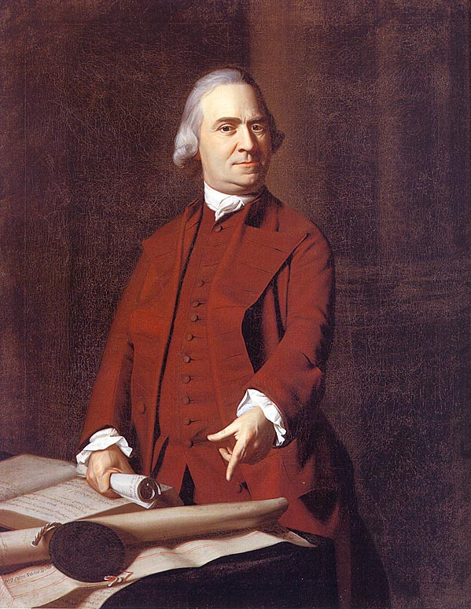
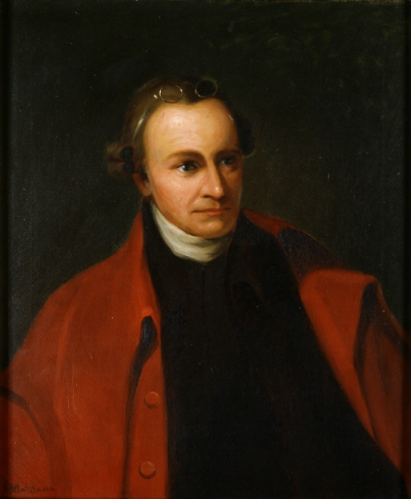
Federalists vs. Anti-Federalists
Anti-Federalists
Those who didn’t want the Constitution to be passed
Included Thomas Jefferson, George Mason, Patrick Henry, and Sam Adams
Problems with the Constitution
Believed Constitution made the Federal government too strong and took too much authority from the states
Don’t want to have the Revolution to be for nothing
The Constitution originally did not have a Bill of Rights
Thought the President would soon become a King

Slide 5
Debates Begin
Heated debates begin, with each side trying to persuade the different states and voters to vote the way they wanted to

Slide 6
How About You?
Which side of this argument do you agree with? Why?

Slide 7
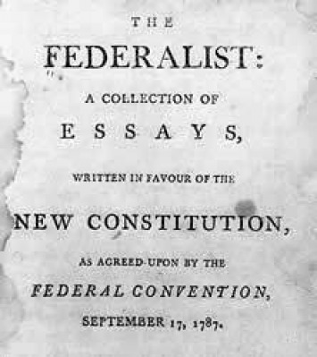
Federalist Papers
One of the most important defenses of the Constitution was a series of essays and newspaper articles known as the Federalist Papers
Written by “Publius”
Actually Madison, Hamilton, and John Jay
Reassured the people that the new stronger national government would not overpower the states and was needed for the welfare of the entire nation

Slide 8
“Nothing is more certain than the indispensable necessity of government, and it is equally undeniable, that whenever and however it is instituted, the people must cede to it some of their natural rights in order to vest it with requisite powers.” (Federalist No. 2)
Governments are necessary, and in order to make governments work citizens must yield some of their rights to it.

Slide 9
Ratification
The Constitution only needed 9/13 to be ratified (accepted); but it needed to be unanimous to be truly effective.
Delaware was the 1st State
Rhode Island was the last
Federalist Papers were very affective
Many states only ratified after being promised a national Bill of Rights

Slide 10
Bill of Rights
Antifederalists feared that the stronger national government would take away the rights of individual citizens and wanted a guarantee that would NEVER happen
Bill of Rights were the 1st 10 amendments (changes) to the Constitution that listed various rights the national government promised to not infringe upon

