Slide 1
Constitutional Convention
A series of compromises

Slide 2
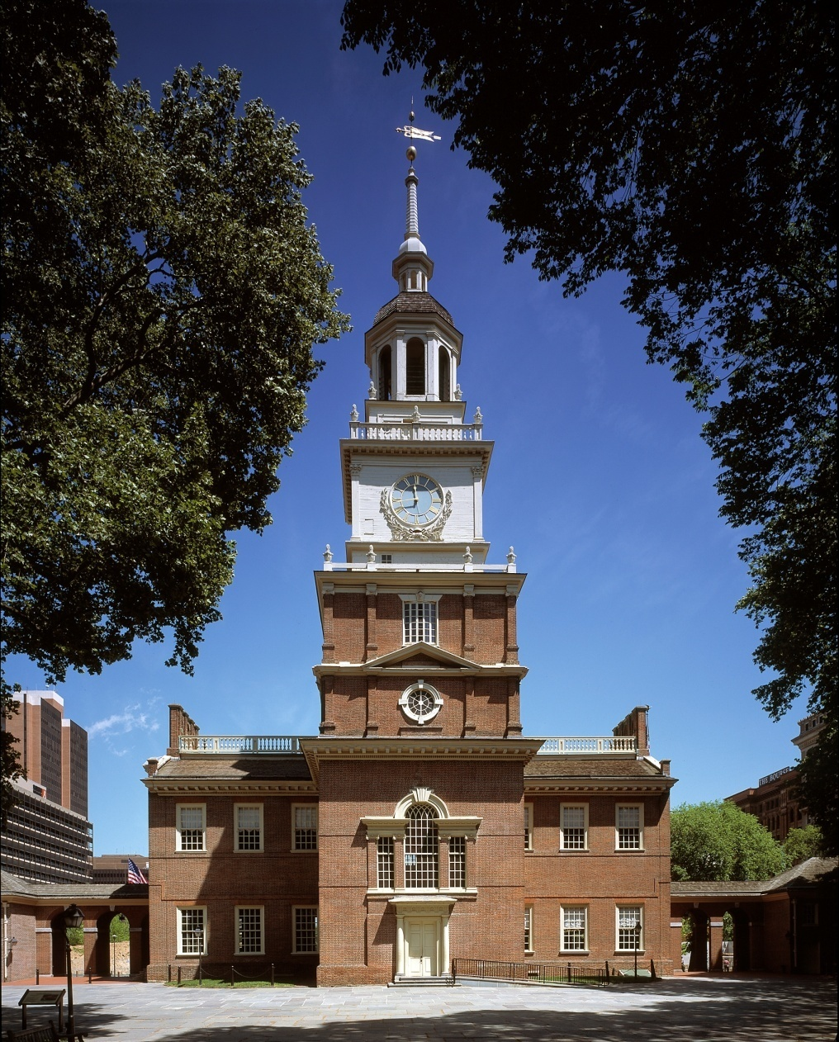
Failures of Articles of Confederation
Leaders of the new states saw that the Articles of Confederation were not working
  Fed. Government couldn’t tax
    No army
      Foreign relations suffered
  Fed. Government couldn’t enforce laws
  States competing with one another
    Led to economic depression with no regulation of interstate commerce
Sent delegates to Philadelphia amend the Articles

Slide 3
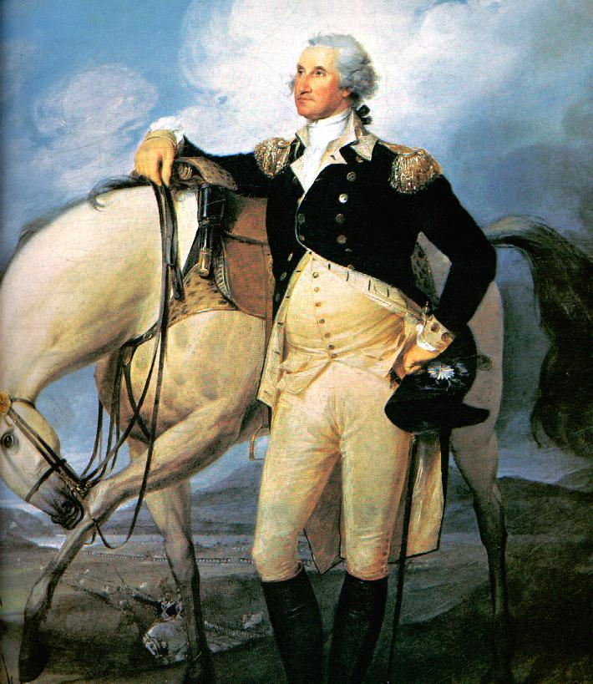
How can you get states behind the Convention?
States are wary of this meeting, so how do you think you could make them not worry so much? Is there somebody you can get that everybody trusts?
George Washington is the hero of the country. He led us to victory in the Revolution, so when he agrees to attend the Convention more people start to support it. Described as the “Indispensable Friend”
What do you think this name means?

Slide 4
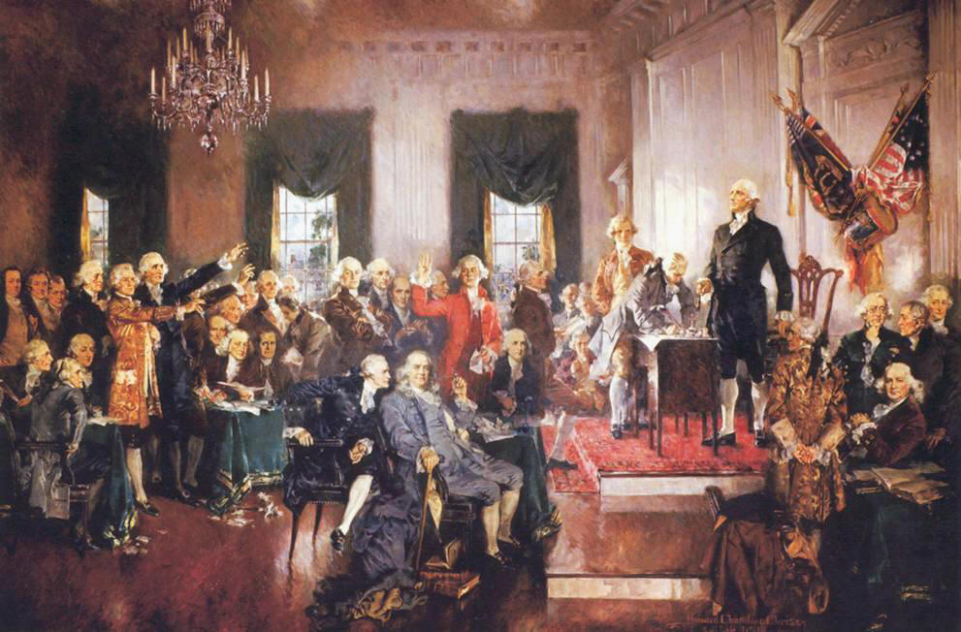
Members to the Convention
States send the best they have
  George Washington: President of the Convention
  George Mason: Father of the Virginia Bill of Rights
  Benjamin Franklin: Sage-like wisdom
  Alexander Hamilton: Advocate of strong federal government
  James Madison: advocate of strong federal government.
  “Father of the Constitution”

Slide 5
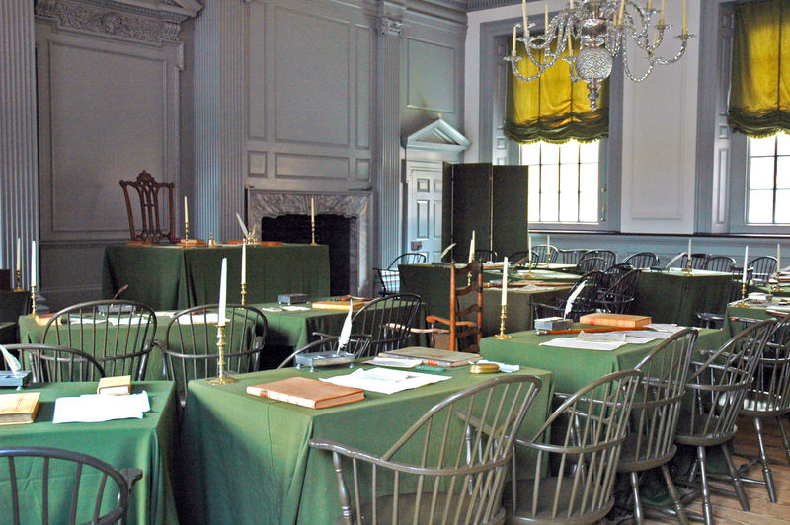
No More Articles
They quickly saw that the Articles need more than just fixing, they need a whole new document
There are a lot of arguments on the best way to set up a new government
  How are states represented?
  Who would enforce laws without giving them too much power?
  What can the states do in relation to the federal government?

Slide 6

Checks and Balances & Federalism
The Delegates agreed that the national government needed to be stronger, but didn’t want it to be too strong
  As a result the powers were split amongst 3 different branches and a system CHECKS AND BALANCES were developed
    Each branch had the ability to limit the power of the other two.

Slide 7
Checks and Balances & Federalism
Under the system of Federalism, states had to follow laws passed by the central government, but any power not given to the national government was under the authority of the states
To further prevent the new central government from getting too strong, a system of Federalism- the sharing of power between the national and state governments was established.

Slide 8
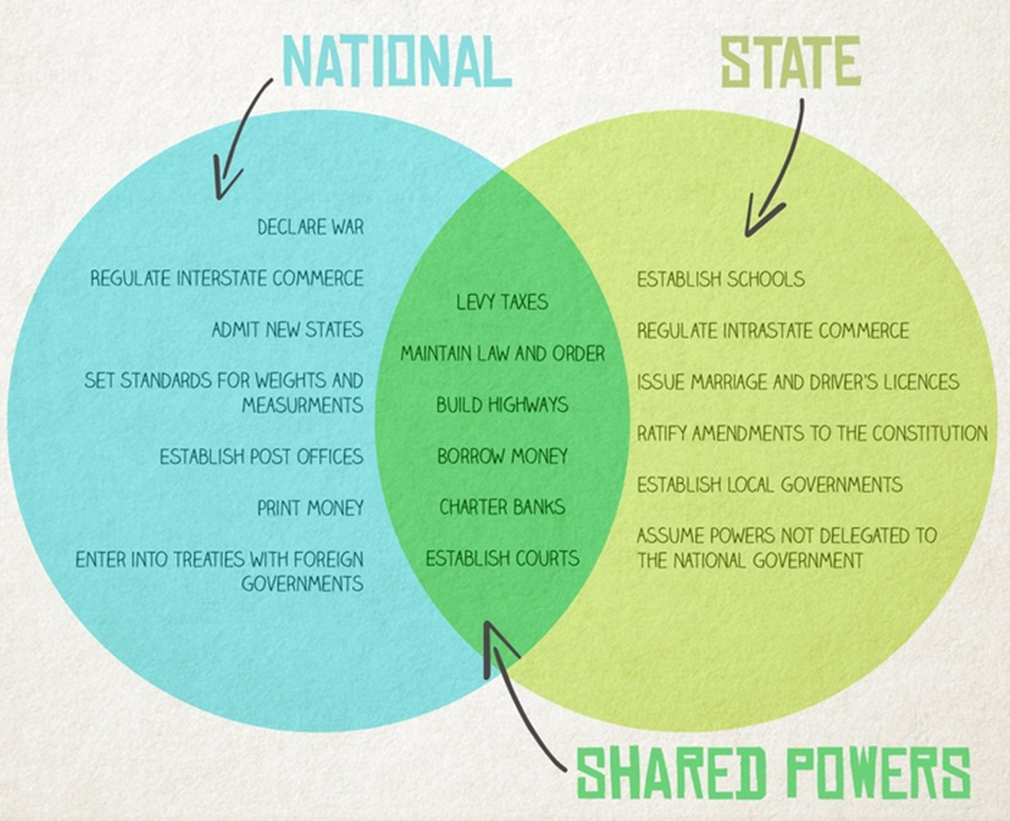

Slide 9

How do you think the various sized states will want to be represented at the national level?

Slide 10

Two Differing Plans
Virginia Plan
Executive Branch:
  Enforce laws
Judicial Branch:
  Interpret laws
Legislative Branch:
  Made up of 2 Houses
  Representation determined by the population of a state
  Who does this benefit?

Slide 11
Two Differing Plans
Executive Branch:
  Enforce laws
Judicial Branch:
  Interpret laws
Legislative Branch
  1 House where representation was equal for all states
Which type of states would prefer this plan to the Virginia Plan?

Slide 12
Which side do you think makes more sense?
VS

Slide 13

The Great Compromise
Executive Branch:
  Led by a President
Judicial Branch:
  Headed by the Supreme Court
Legislative Branch:
  Senate: all states have equal representation
  House of Representatives:
    number of delegates would be determined by population

Slide 14
“We hold these truths to be self-evident that all men are created equal….”
What about this opening line of the Declaration of Independence doesn’t make sense or seem right based on what we know about early American society?

Slide 15
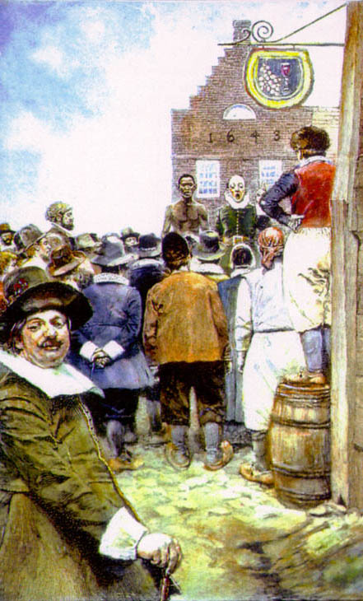
Slavery in United States
Huge parts of the population of America were African slaves
Many of the Founders saw that slavery was evil and wanted to end it, but knew that the Constitution wouldn’t be accepted by the Southern states if it was outlawed.
  Slavery was becoming less profitable and many founders thought the institution would die off on its own due to economic reasons

Slide 16
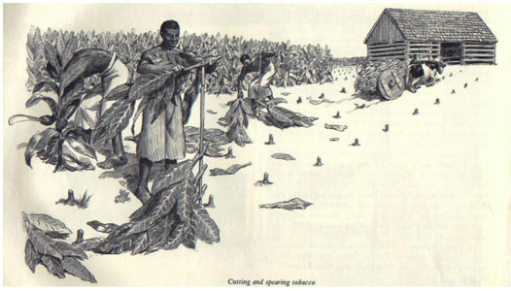
Part of the Population?
Slavery also brought up the question of how they should be considered when determining the population of the state
  Who would want them counted? Why?
  Who wouldn’t and why?

Slide 17



3/5 Compromise
=
The two sides compromised and decided that 1 slave would count as 3/5 of a person
  However, they also agreed that the slave trade will stop in 20 yrs.
  Founders believed that the institution of slavery would end soon anyway since it had become unprofitable

