Slide 1
Common Sense

Slide 2
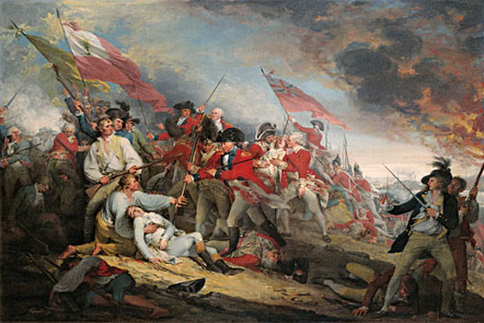
Many on the Fence
Despite the fact that the American’s enjoyed early successes in the war
- Fort Ticonderoga
- Bunker Hill
Many colonials were still undecided and still many others want to remain loyal to England

Slide 3
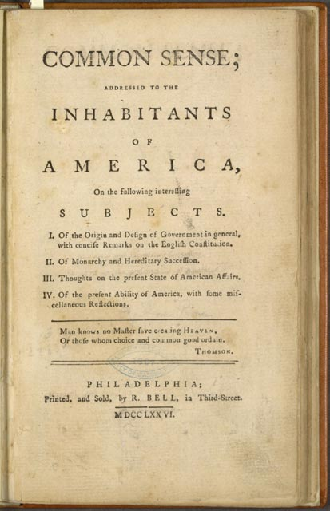
Common Sense
A 50 page pamphlet by Englishman Thomas Paine came out in early 1776 that helped change people’s minds
It was called Common Sense

Slide 4
Why do you think Paine titled it “Common Sense”?
He believed the arguments he is going to make should be obvious to everybody, that it should have been ‘common sense’.

Slide 5
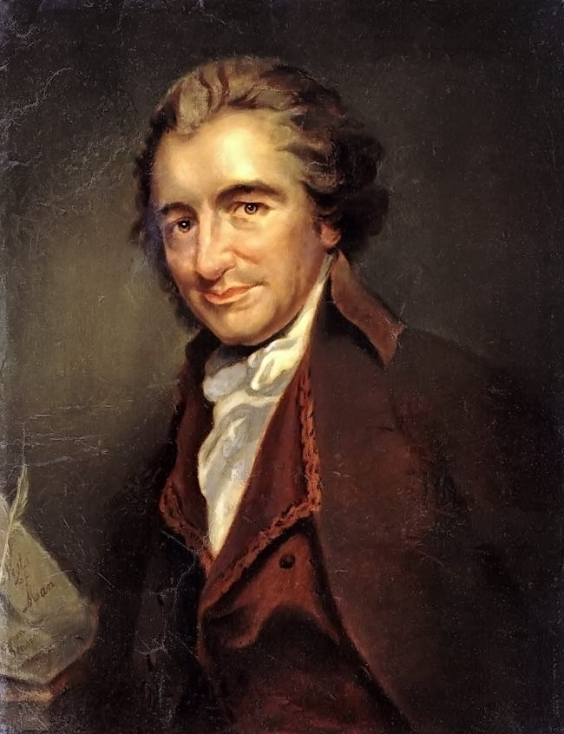
I challenge the warmest advocate for reconciliation, to show a single advantage that this continent can reap, by being connected with Great Britain. I repeat the challenge, not a single advantage is derived. Our corn will fetch its price in any market in Europe, and our imported goods must be paid for, buy them where we will… Everything that is right or natural pleads for separation. The blood of the slain, the weeping voice of nature cries, ‘TIS TIME TO PART.
I challenge the warmest advocate for reconciliation, to show a single advantage that this continent can reap, by being connected with Great Britain. I repeat the challenge, not a single advantage is derived. Our corn will fetch its price in any market in Europe, and our imported goods must be paid for, buy them where we will… Everything that is right or natural pleads for separation. The blood of the slain, the weeping voice of nature cries, ‘TIS TIME TO PART.

Slide 6
Common Sense
Paine argues that:
the very idea of kings is crazy
America does not benefit at all from England
Full independence would not only benefit the colonies would make it thrive and makes sense

Slide 7
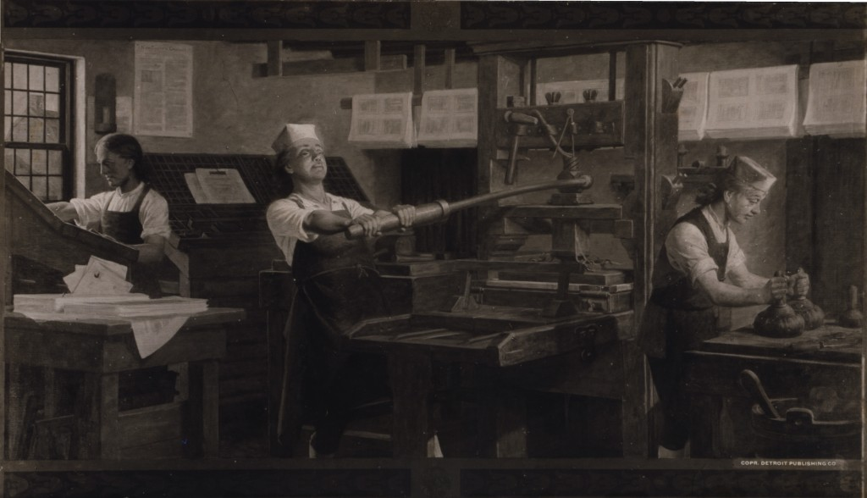
Effect of ‘Paine’
After reading Common Sense more people were calling for independence
Used blunt direct language that really got people’s attention
It became the first best seller in the colonies
Sold over 500,000 copies

Slide 8
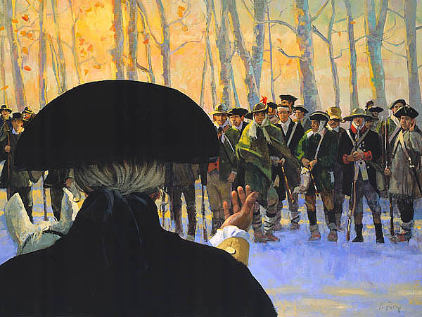
Effect of ‘Paine’
Washington made all of his troops read the pamphlet, giving a clear and powerful answer as to why they were fighting.
Support for independence grows in the colonies

Slide 9
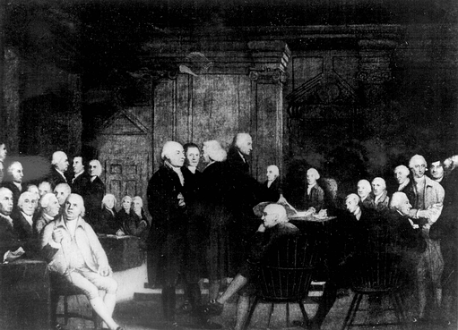
Independence?
Members of the Continental Congress begin to discuss formally breaking away from England
The war would now be for full independence
Originally the goal was reconciliation
Had to write a document explaining the breakaway first

