Slide 1
Britain’s Acts
&
Colonial Response

Slide 2

Trying to Pay off Debt
In order to pay off their huge war debt, Parliament did pass several acts, taxing the colonists
    Navigation Acts
      Colonies could only trade with the mother nation
        Previous law that was now strictly enforced
        Smugglers harshly punished
        Smugglers tried by British courts; not colonial ones

Slide 3
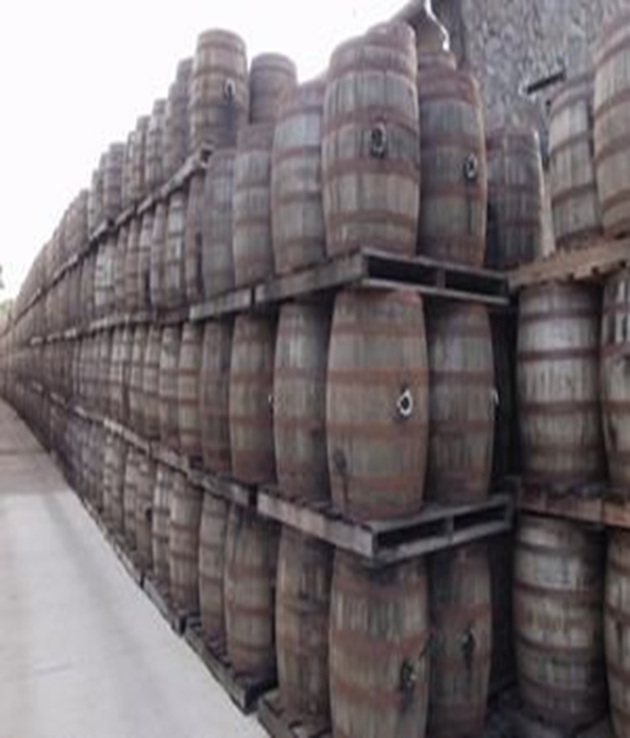
  Sugar Act 1764
  2. Sugar Act 1764
    Goods like molasses, rum, anything using sugar is now taxed

Slide 4
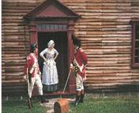
Quartering Act- 1765
  Over 10,000 British soldiers were stationed in the colonies to help keep the peace with the natives
    In order to help cover the cost of providing for these troops, Parliament passed the Quartering Act
    Forced colonists to feed and house troops in their homes

Slide 5
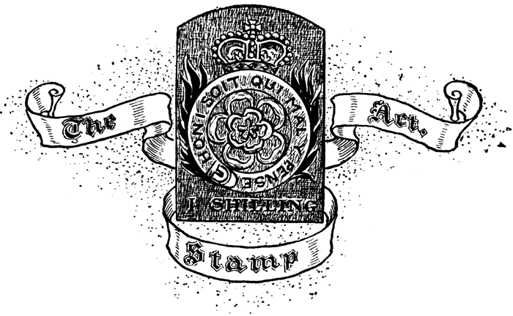
Stamp Act- 1765
Most important, Act passed by Parliament was the Stamp Act
  Required colonists to buy stamps for all of their paper products
    Newspapers
    Letters
    Deeds
    Wills
    Licenses
    Contracts
    Playing Cards

Slide 6
Asking Too Much?
This tax wasn’t very expensive
  About a penny more
Colonials argued that it wasn’t the money, but rather the principle. Issue of ‘No Taxation Without Representation’ still not resolved.

Slide 7
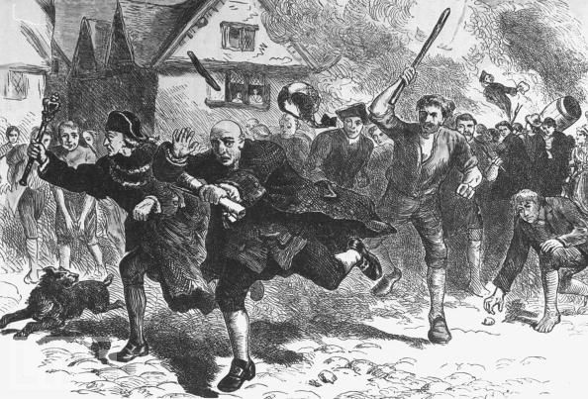
Violence in the Streets
Riots and violence against agents of the government were commonly attacked on the streets

Slide 8
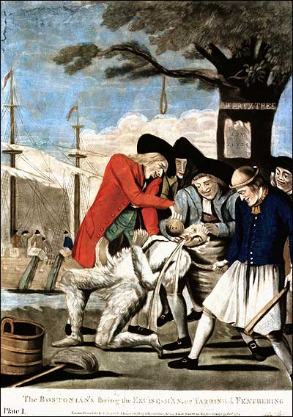
Violence in the Streets
A common fate was tarring and feathering
  Victim was covered in boiling hot tar
  Feathers were then dumped on top
  Extremely painful
    Many died as a result

Slide 9
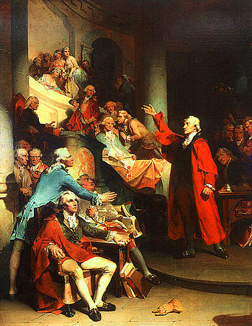
Colonial Legislatures
Colonial legislatures began to speak out and unify against the Acts passed by Parliament
  Patrick Henry
    Member of the House of Burgesses, who was known for his magnificent oratory

Slide 10
Colonists are United
Colonists began to band together to resist the new taxes
Boycott: organized campaign to refuse to buy certain products
Why would unity be essential in a boycott?
If one or a few individuals don’t buy a product, it will not have much effect
However, if many people refuse, it will have a drastic effect

Slide 11
Colonists’ Official Means of Protests
Sent petition to Parliament to end both the Sugar and Stamp Act
  Petition: written request
Effects
  Parliament gave in…..kinda
    Repealed the Stamp Act
    Repealed Sugar Act
    Passed Declaratory Act
      Claimed Parliament had total authority over colonies

