Slide 1
Boston Massacre

Slide 2
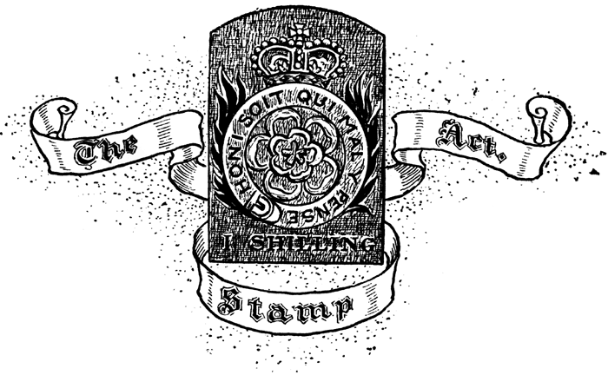
What was the Act that placed a tax on all paper products in the colonies? What was the colonial response to this Act?
Stamp Act placed tax on all paper used in colonies, and the colonists were furious at this act by Parliament.

Slide 3
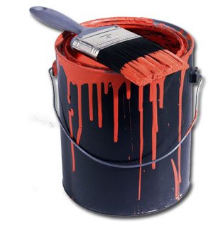
Townshend Act- 1767
Following repeal of Stamp and Sugar Acts, the British government still needed a way to pay back its debt
Parliament passes the Townshend Act in 1767
Now, only tax things coming into the colonies (imports)
Lead
Paint
Paper
Glass
Tea

Slide 4
Since buying these products legally is now more expensive, what will more colonists have incentive to do?
Buy them illegally! Smuggling!

Slide 5
If you worked for the British government, how could you prevent the colonists from bringing in illegal goods?

Slide 6
Writs of Assistance
To help prevent smuggling, Parliament allowed the British troops to use writs of assistance
Court orders that allowed British to enter houses without a warrant.

Slide 7
Colonial Responses
Colonists saw this as a violation of their natural rights and are going to resist this Act in a variety of ways.
Boycott British Goods
Colonial Assemblies refuse to give funding for ‘illegal’ searches
King suspends Assemblies

Slide 8
Tensions Running High
Colonists are going to be angry
Having soldiers amongst them is setting the stage for violence

Slide 9
Repeal of the Townshend Acts
On March 5, 1770 Parliament repealed the Townshend Acts, bowing to the petitions and boycotts of the colonies.
Kept tax on tea as a point of principle.
Too little too late…..

Slide 10
Boston Massacre
On March 5, 1770 (same day the Townshend Acts were repealed) and angry mob developed in Boston
Began throwing snowballs, sticks, stones, and bricks at a group of soldiers

Slide 11
Boston Massacre
In the following confusion, the soldiers opened fire on the mob killing five
Including Crispus Attucks, an African American sailor

Slide 12
Boston Massacre
Murder trials were held for the soldiers in Boston
They were defended by well known Boston lawyer John Adams
Believed in colonial causes
Also believed in fact that everybody deserves a fair trial

Slide 13
Boston Massacre Trial
Adams was able to get all but two soldiers off the hook
Those two were convicted of the lesser crime of manslaughter and branded
Despite the verdict, many people still blamed the soldiers

Slide 14
Effect of Boston Massacre
Following the “Massacre,” Bostonian Paul Revere created a picture depicting the event that spread throughout the colonies

Slide 15
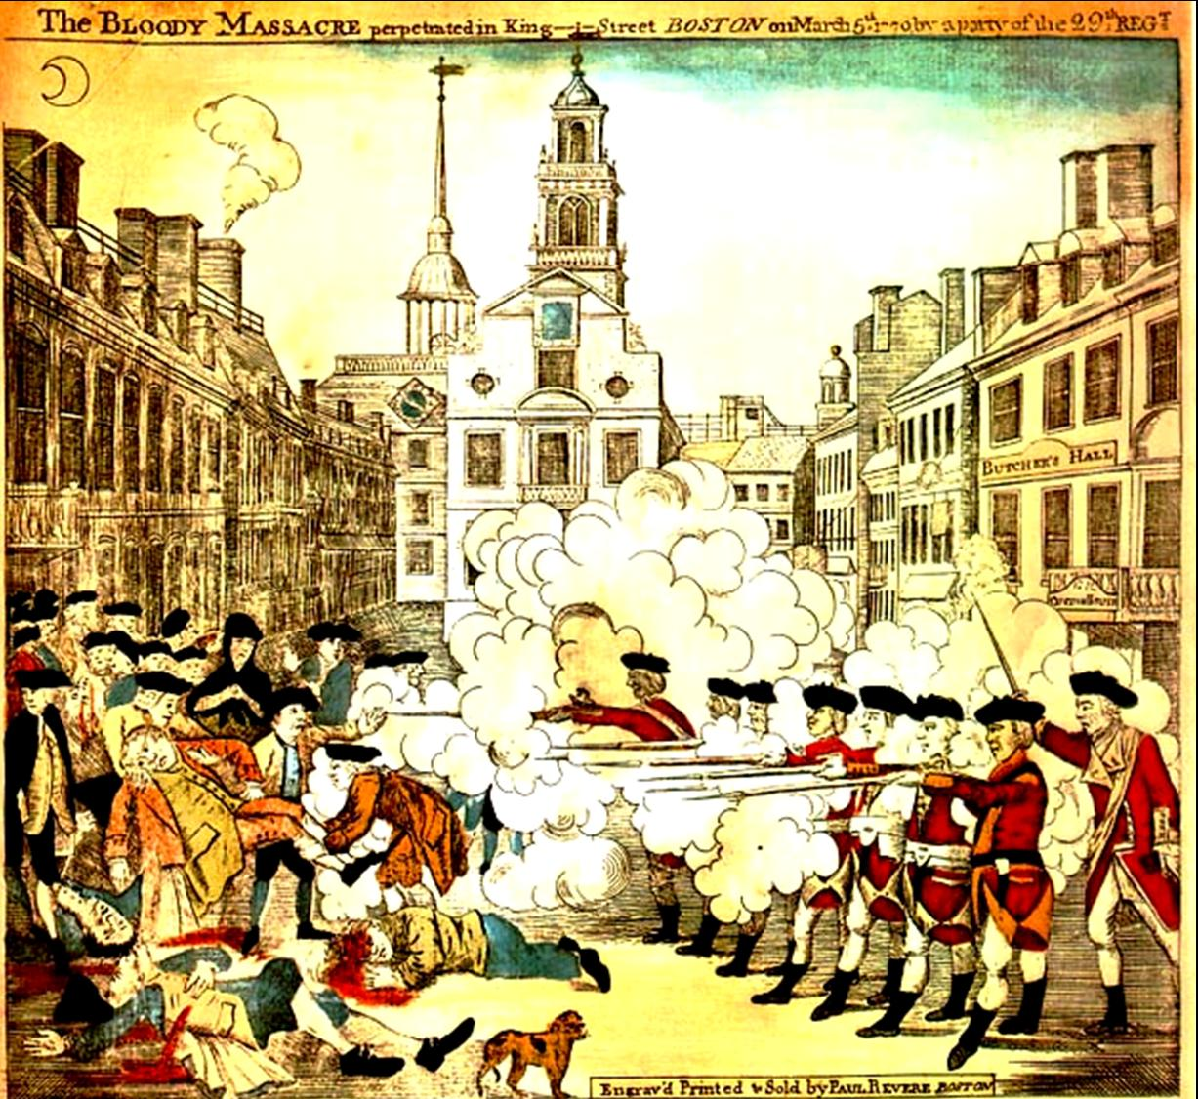

Slide 16
Effects of Boston Massacre
This image spread throughout the colonies, infuriating the colonists that the soldiers would fire on “innocent” civilians.

