Slide 1
Bill of Rights
Protecting the Rights of the People

Slide 2
There is nothing in the original Constitution that guarantees rights to individual citizens
Where in the Constitution does it protect the rights of the citizens of the United States? Is it mentioned at all in Article 1, 2, or 3?

Slide 3
Passage of the Bill of Rights
One of the key arguments Anti-Federalists made against the Constitution was that it did not include a Bill of Rights.
Many states demanded that once the Constitution went into effect, they would add a Bill of Rights

Slide 4
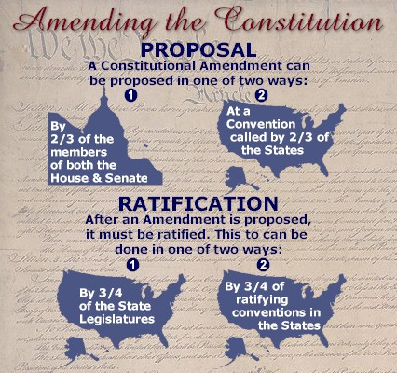
Amendments
One of the first things the new Federal government had to undertake was amending the Constitution
Amendment: addition to a document
The Framers knew the Constitution had to be flexible enough to change and adapt to new situations
Not easy to do: proposed by both Houses and 38 state legislatures vote yes

Slide 5
Bill of Rights
One of the first things the new Congress did was pass 10 Amendments that were designed to protect the rights of individual citizens
Bill of Rights
What sort of rights are protected by this document?

Slide 6
Bill of Rights
Freedom of Expression
Religion, Speech, Press, Assembly, and Petition
Bearing Arms
Quartering of Troops
Search and Seizures
Need a warrant to search
Criminal Proceedings; Due Process; Eminent Domain
No double jeopardy
Accused doesn’t have to testify against themselves
Fair trial
Government must pay you for your land

Slide 7
Bill of Rights
Criminal Proceedings
Impartial jury in a speedy trial. Must be told the charges and given a lawyer
Civil Trials
In trials involving more than $20 dollars, a jury is needed
Punishment for Crimes
No excessive bail and no cruel and unusual punishments
Unenumerated Rights
Rights are not limited to this list. Government can’t say these are all people have
Powers Reserved to the States
Any power not given to the Federal government or forbidden to the states, are reserved for the states or to the people. They can also do some things that the national government can do (concurrent powers ex. Taxing)

