Slide 1
According to Jefferson, what do people have to do if the government does not protect the rights of the people?
The people have the right to overthrow their abusive government and establish one that will be more responsive to the will of the people

Slide 2
The Articles of Confederation

Slide 3
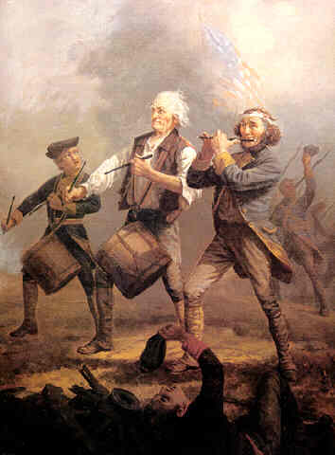
That was the purpose of the Revolution, to remove the abusive British government
What does the U.S. have to do now?
Now that the British are gone, a new government must be established
Brings up a lot of questions
Who should be in charge?
What type of government should we create?
How can we be sure they don’t abuse their power also?

Slide 4
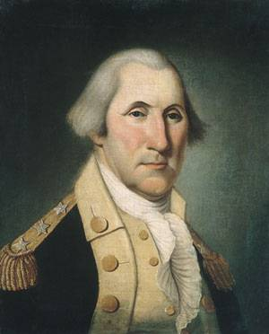
What sort of government do you think we will want to establish? Who should be in charge?
Many want to crown Washington king of America
Do you think this would be a good idea? Why or why not?
Washington refused
Contrary to the principles of the Revolution
Resigned from the army and retired back to his plantation

Slide 5
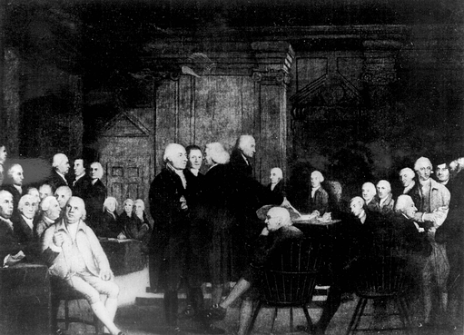
Early Governments
Most of the power in the individual states was be given to the legislature- elected representatives who make laws (legislate)
They were tired of giving power to a single individual who could do whatever they wanted

Slide 6
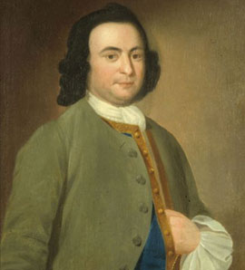
Early Government
Many states tried to correct the mistakes of the British in their state constitutions- documents saying how a government will run:
More people could vote
Land owning white males
Not women or minorities
Did more to protect individual rights
Virginia Declaration of Freedom (1st Bill of Rights)
George Mason
Freedom of Religion
Freedom of the Press
Trial by Jury
Limited Arrests and Searches
No ‘cruel and unusual punishments’

Slide 7
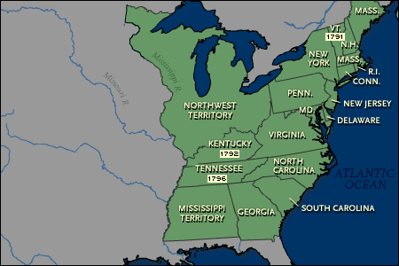
National Government
Most of the power would be at the state level but the national, or federal, government did have some limited powers
Articles of Confederation
America’s 1st federal/national constitution
States would “firm league of friendship”
Loose connection
“United States of America”

Slide 8
Articles of Confederation
At the federal level all power was given to one group of legislators
Lacked the power to tax, had to ask the individual states for funds
Declare war and make peace
Make treaties with foreign countries
Hear disputes among the states (but not enforce decisions)
No executive- individual who enforces the laws passed by the legislature
There will be nobody to make sure the states follow what the federal government says
States can choose which laws they want to obey or give funds
What implications do you think the absence of an executive will have?

Slide 9
What are your reactions to the provisions in the Articles of Confederation? Does it sound like it created a strong national government? Why do you think they worked well early on
(1776-1781)?

Slide 10
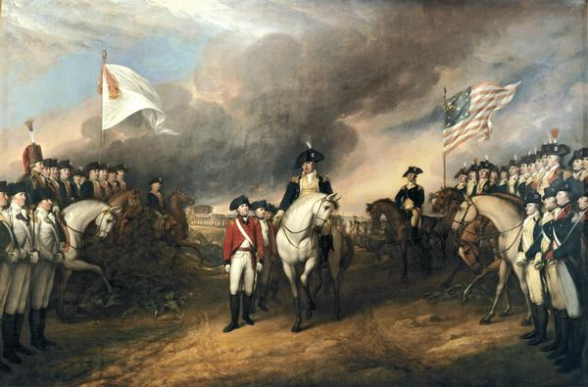
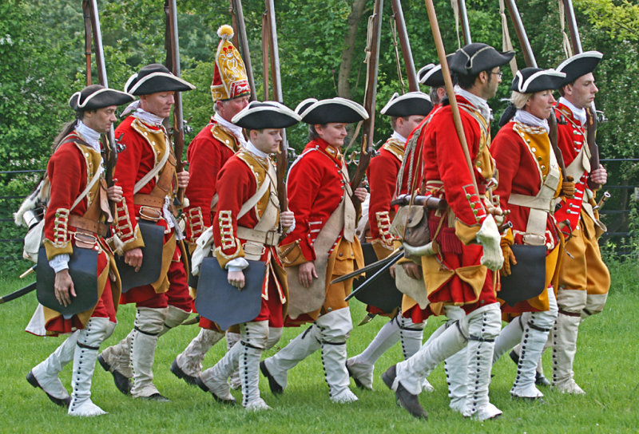
Articles of Confederation
Early on:
The Articles work
States are willing to work together (and have to) in order to defeat the British
What about once the war is over?
Once the British are gone….so is the need for states to work together.

